Slide 1
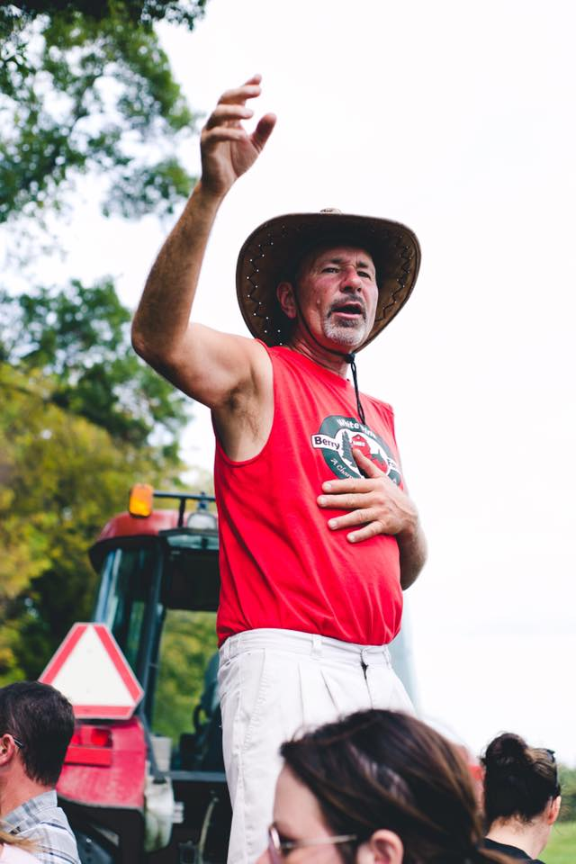
Welcome to White Pine

Slide 2
U-Pick Berry Farm
Strawberries ~ June
Raspberries ~ July-Frost
Blueberries ~ July & August
Sunflowers ~ August
Corn Maze & Pumpkin Patch

Slide 3
EVENTS AT WHITE PINE
Strawberry Shortcake Day
Fall Family Days
A Day on the Farm & Eat Local Coop Farm Tour (Canceled 2020)

Slide 4
Covid 19 Changes
Post your policy on Website and Social Media!
We did our best to accommodate all by separating those who were “covid cautious” from those who were not as cautious
Trained employees to use the word “comfortable”
Posted social distance reminder signs with hand sanitizer
2nd Hand Washing Station

Slide 5
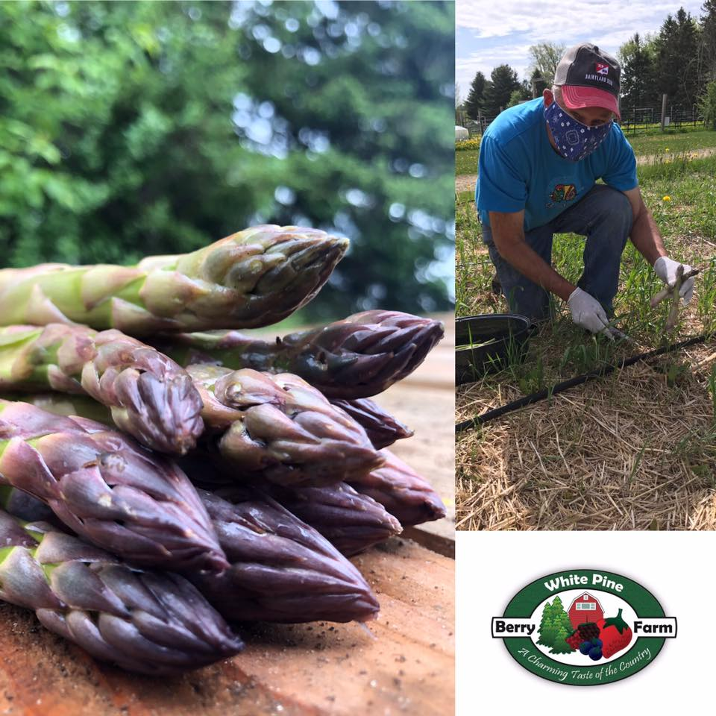
Pre-Picked Orders
Pre-picked Orders offered when berry supply was beyond U-Pick demand
Combination of Online & Phone Pre-picked Orders

Slide 6
Covid Plan for U-Pick Strawberries
Open 7 days a week
Offer two different areas with different systems
Flag system for more Covid Cautious
Our classic, Scattered approach where customers go where they want
Separate weigh station with 6’ social distancing posts during peak times

Slide 7
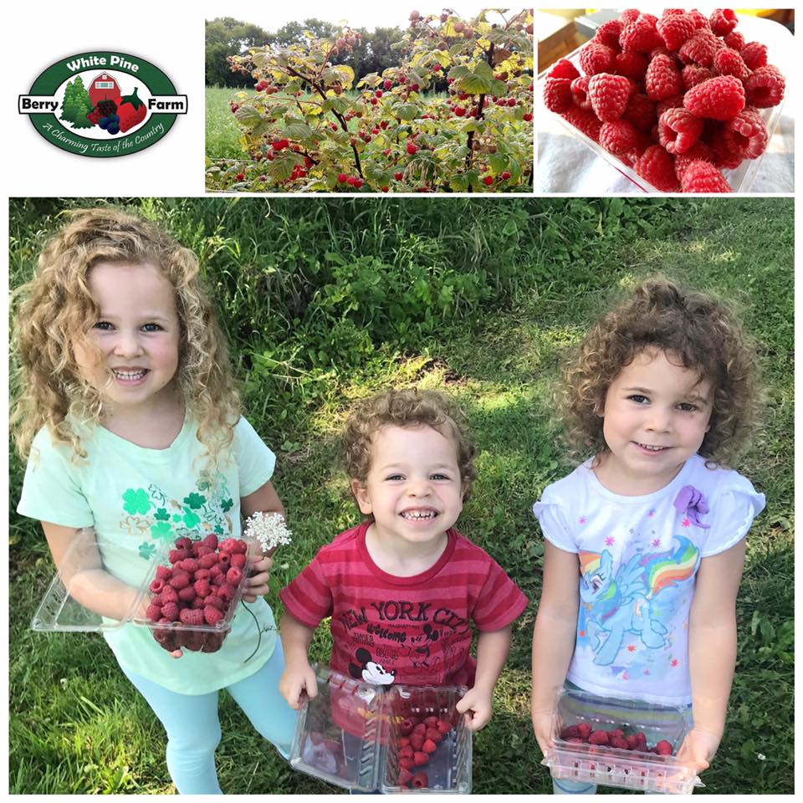
Raspberries & Blueberries
Open 3 days a week for all or by appointment for “Covid Cautious”
Team Member gets customer started on a plant away from others

Slide 8
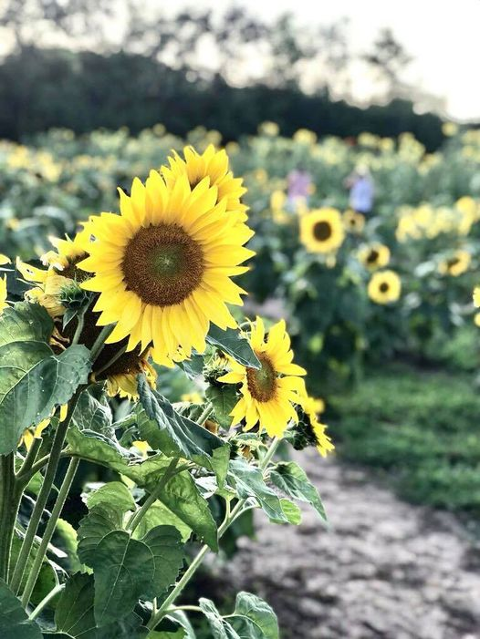
Sunflowers
Open 4 days a week and by appointment
Cut extra paths for an easy exit.
1 way direction

Slide 9
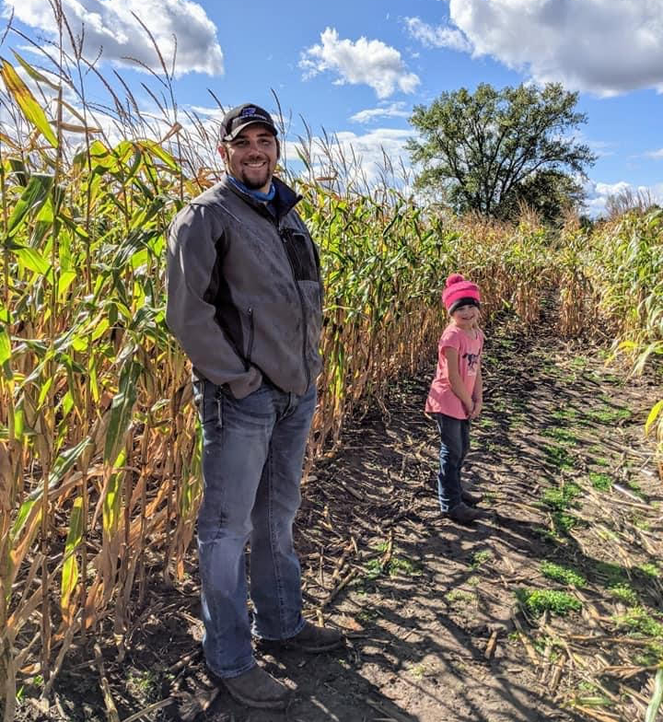
Fall Activities
Similar to berries, we did our best to accommodate all by separating those who were “covid cautious” from those who were not as cautious
Saturdays were similar to our Fall Family Days with all activities open
Sundays open for “Covid Cautious” with Corn Maze, Pumpkin Patch, Wagon Rides, Farm Store & Goats
Increased Sanitation on Surfaces

Slide 10
Mask Policy in New Building
Opened new building September 26th with Farm Store & Kitchen
Required mask for team members inside the building
Put sign up on both doors and on busy days placed out masks.
Offered contactless checkout with Square, but still accepted cash or check.

Slide 11
Thank you
www.whitepineberryfarm.com
berries@whitepineberryfarm.com
715-222-2946

