Slide 1
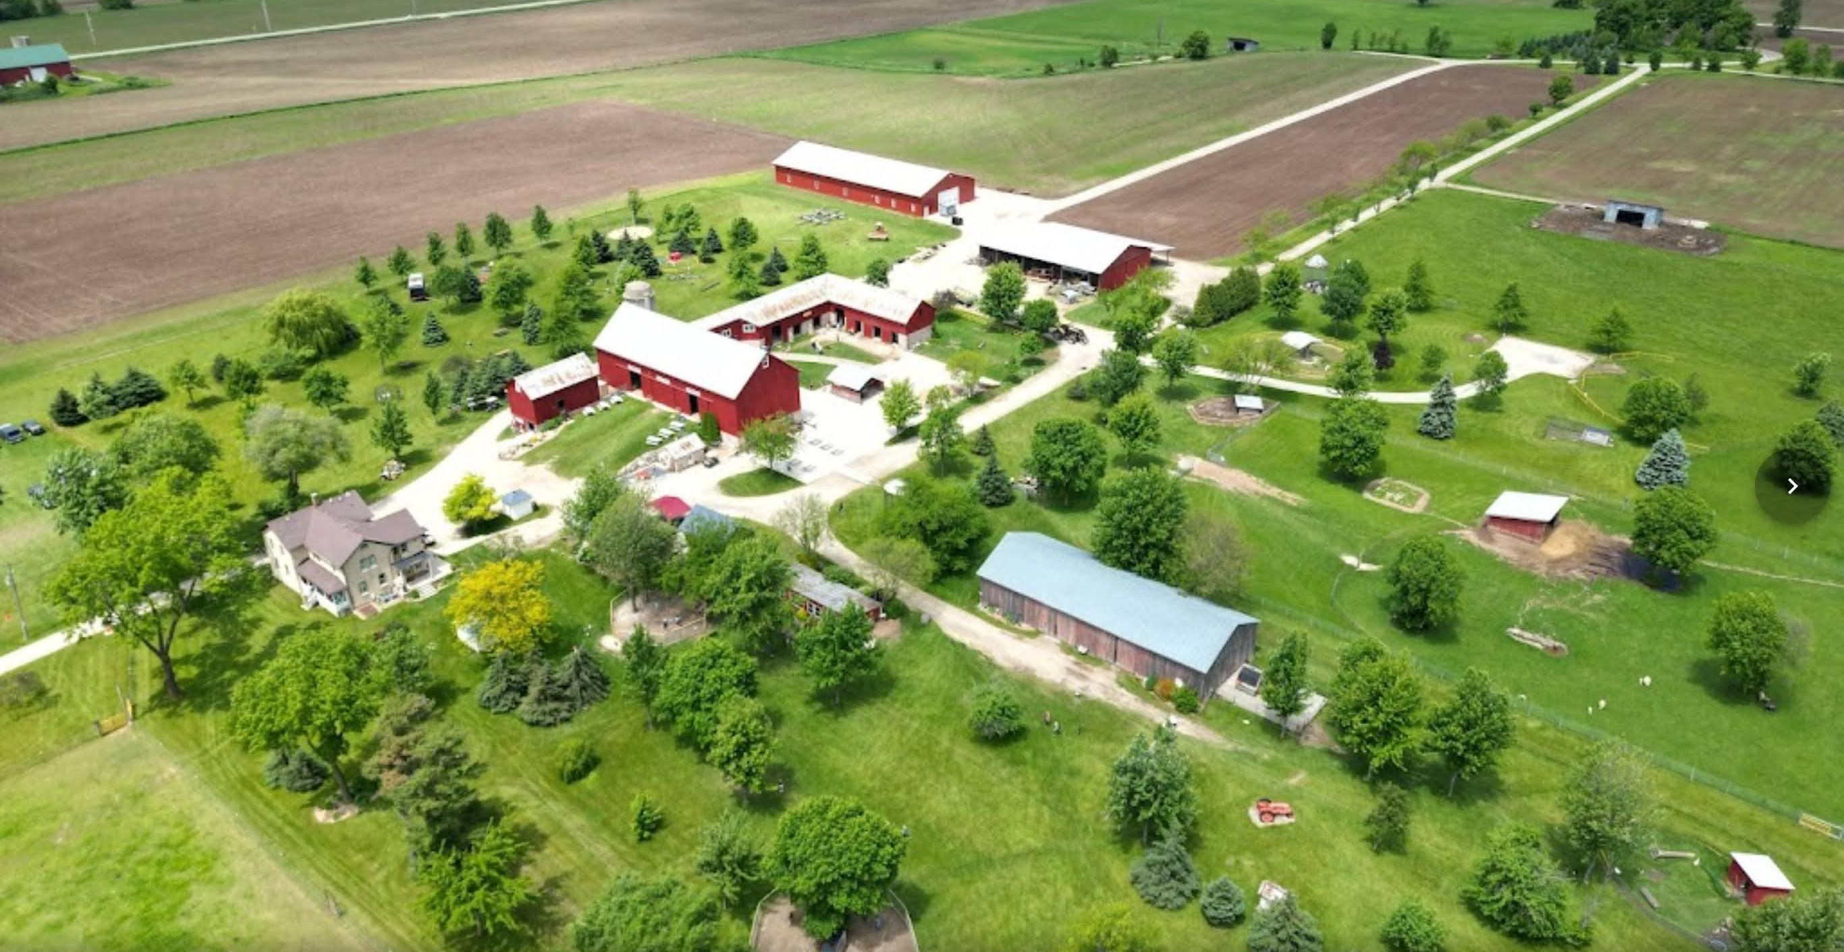
Agricultural Tourism Tours - Educational Tours
Bonnie Keyes, Mulberry Lane Farm
Notes:
We are located in Hilbert just 3 miles east of Sherwood at the northern tip of Lake Winnebago

Slide 2
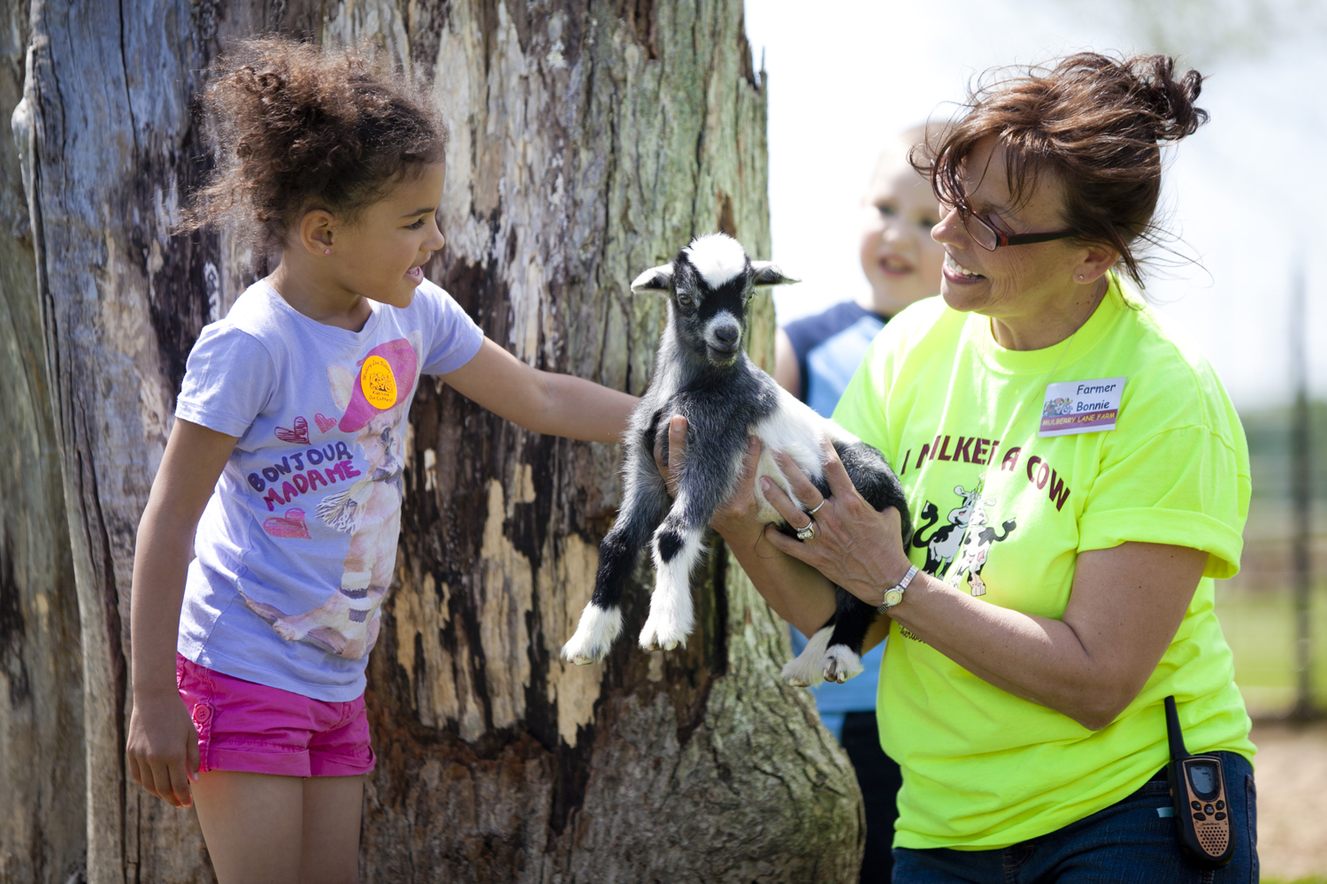
Educational Tours
Mission Statement*
3 Main Sources of Revenue
Guided: School Field Trips - Reserved Grps of 20+ Majority are pre-school to 2nd grade
Self-Guided: Families (No resv needed)
Weddings
Our Mission…is to provide an ideal country learning environment where people of all ages can interact and learn about farm animals through “hands-on” group & self-guided tours.
Notes:
When we opened in 2005 school field trips were our only focus.
Over the years we diversified & targeted families more.
Some was a natural transmission because of the 2009 recession when schools eliminated field trips from the school budget. Bounced back but then we ran into COVID where we had practically zero field trips for a year and half.
Oct 2005 – 3200 students/field trips w/ only 507 in families
That has shifted to
Oct now – 20,000+ in families and 5-7,000 students

Slide 3
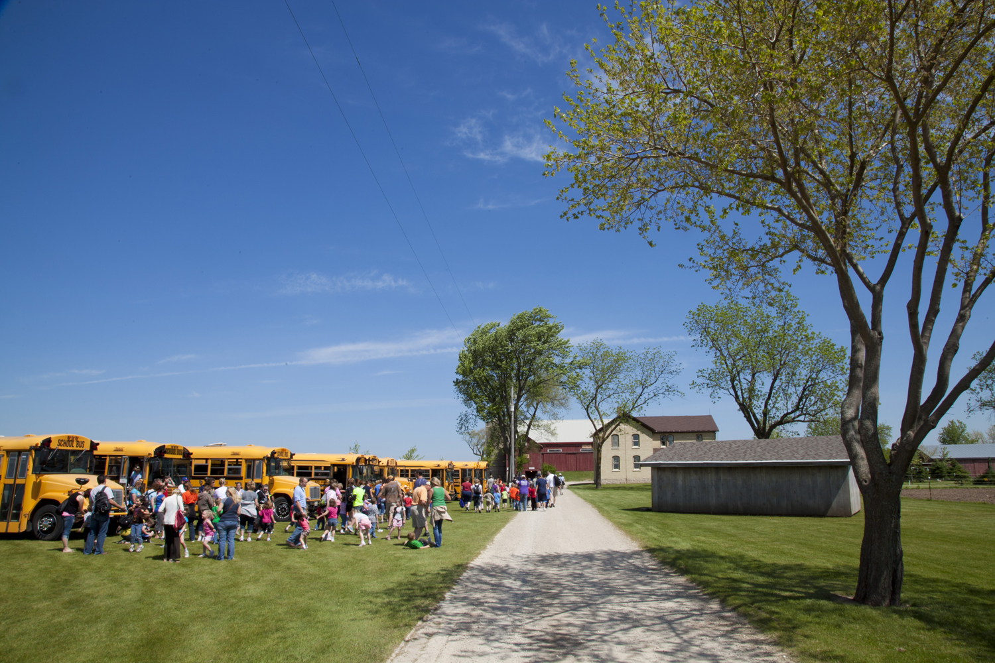
Educational Tours
Guided: School Field Trips - Reserved Grps of 20+
Notes:
Today I’ll be focusing on our school field trips.

Slide 4
Educational Tours
How we market
Began w/ handwritten, self-addressed envelopes
Purchased mailing list –Switched to google search
Used a catchy envelope to get teachers to open
Now rely on repeat business but contemplating doing another market campaign using the envelope again
Keep our field trip rates as low as possible*
What happens during a tour
How we get them back
Notes:
#4 Since everything has become so digitalized getting a handwritten envelope in the mail has become rather attractive in catching someone’s attention. I know it did me when I recently received a hand addressed promo in the mail. It was an obvious handwritten, not one of those where it’s a cursive font being used.
#5 …. over the years our field trips have become more of a community service vs a huge income source as it was when we 1st opened. This is inline with our mission I shared earlier.
Although we’ve increased our family rate several times since 2005, our field trips remain relatively cheap.

Slide 5
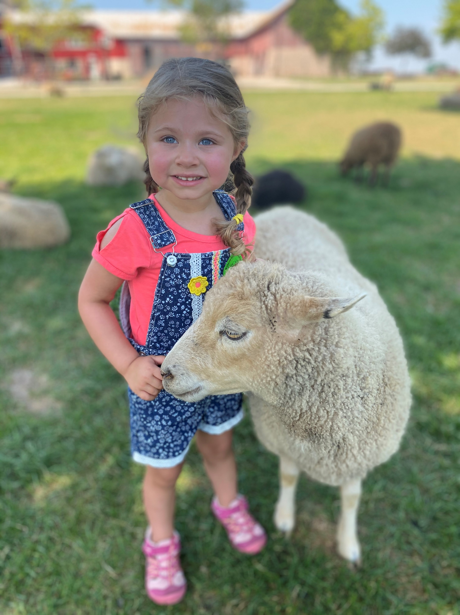
Educational Tours
How we market
What happens during a tour
Assigned a tour guide
Group size 55 to 60*
Educational information w/ hands-on experience
Tour 1½ hr w/ ideal visit 3 hours total*
Once tour complete – animal area no longer available
Spring – feature the newborn baby animals
Summer – focus on play & fun time in the picnic area
Fall – focus on the FREE you-pick pumpkin
How we get them back
Notes:
#2 – We don’t have a required Adult/Child ratio and often find we have more parents in attendance than students.
Teachers share that this field trip is the best attended by the parents
#4 – 15 min. Check-in,
1½ hr tour,
15 min. restroom/clean up,
1 hr to ½ hr lunch & playtime (fall pumpkin patch)
#7 – How the dynamics change
Spring – Last field trip of the school year – year end bash and not so concerned about the animal facts
Summer – day camps, YMCA, Boys & Girls Clubs, Day Cares
Fall – Many it’s the 1st field trip of the school year – teachers are more insistent on the “educational” aspect of the field trip

Slide 6
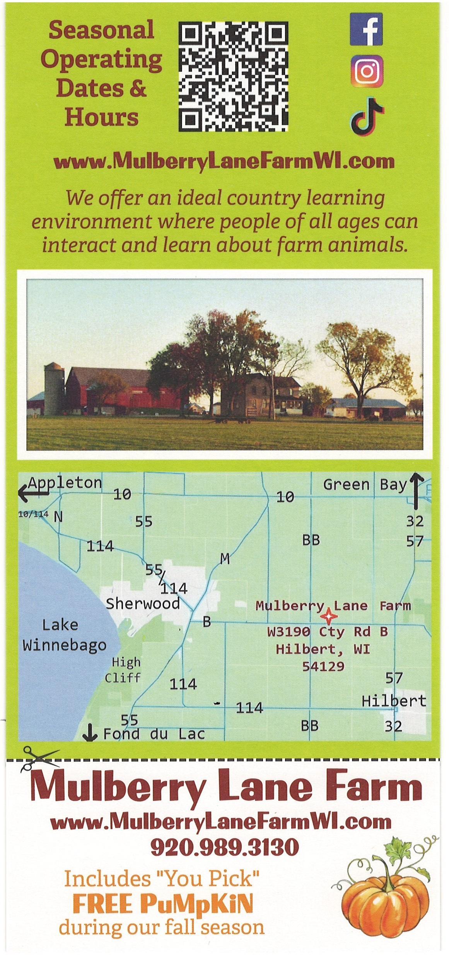
Educational Tours
How we market
What happens during a tour
How we get them back
FREE – has been called the most powerful word in the history of marketing*
Families return for the unstructured “self-guided” tour*
Notes:
#1 – And therefore we every student that visits receives a FREE admission to return.
#2 – Parents often share how Johnny or Susie couldn’t stop talking about the field trip.
We just had to come back and see for ourselves.
No time constraint.
We allow carry-ins so pack a picnic lunch and spend the day.
Admission is more for self-guided unlimited time visit vs. the structured limit of 1 ½ hr tour
Admission to enter the farm vs. free admission and pay for everything you do.
Our highest revenue stream

Slide 7
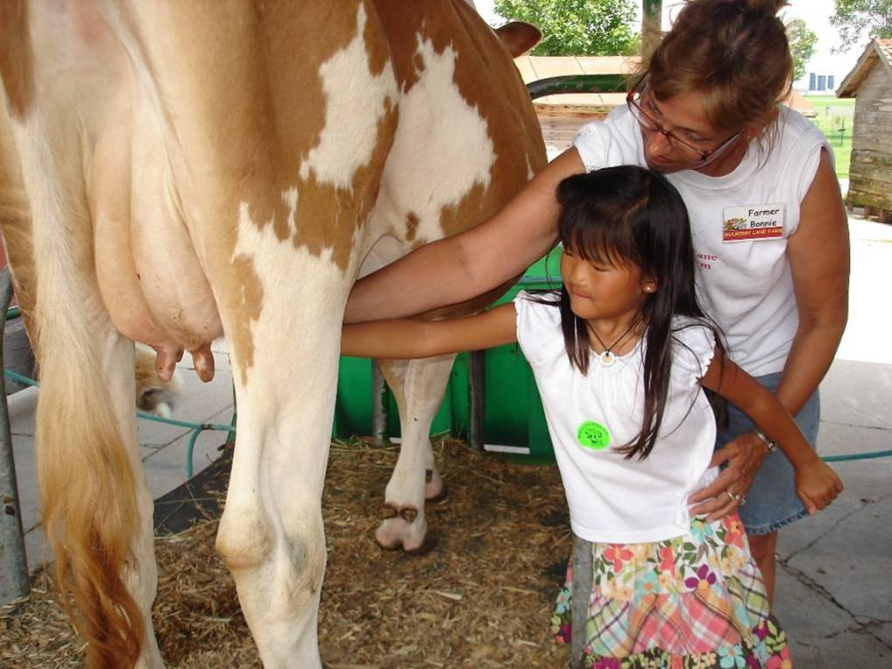
Educational Tours
Take A-way
What is your niche?
What can you do to diversify to bring added revenue
Determine what works for you
Notes:
#1 – Our niche is the hands-on, interactive field trip. Kids get to touch, pet, hold the animals vs. looking through a fence. And of course, our free pumpkins in fall.
#2 – We started w/ field trips and to diversify we focused on families & in 2010 started doing weddings and gradually added other agritourism activities. Mother’s, Father’s & Grandparent’s Day free admissions. Memorial Day Vets are free. Pay Your Age Day.
#3 – Kiley and Abigail are going to talk about Boot Camps and Bus Tours. What’s your agritourism niche? Yoga w/ goats. Cooking classes using farm grown products. Farm stays. On farm restaurant or café. Your imagination is your only limitation.
You do You!

Slide 8
Agricultural Tourism Tours - Educational Tours
Thank you for participating!
Bonnie Keyes, Mulberry Lane Farm
Notes:
We are located in Hilbert just 3 miles east of Sherwood at the northern tip of Lake Winnebago

