Slide 1
Farmer Perceptions of Raspberry and Strawberry Production In Tunnels: Management and Marketing Implications
David Conner
Department of Community Development and Applied Economics
University of Vermont

Slide 2
Overview
Introductions
Me
Objectives
You
Methods
Results
Production
Marketing
Implications/Next steps

Slide 3
Introductions (me)
PhD, Agricultural Economics, Cornell, 2002
Faculty: Michigan State, University of Vermont

Slide 4
Intro-project
Objectives
Selecting tunnel structures & plastics
Optimizing productivity & pest management
Increasing profits
Minimizing plastic waste generation
https://www.tunnelberries.org/

Slide 5
Intro-Agenda
Present Research Results
Vet and discuss: how do your experiences and knowledge compare and contrast with results?
Discussion

Slide 6
Intros (you)
How many of you are
Farmers?
Technical assistance providers/Extension?
Other?

Slide 7
Intro’s
How many of you
Currently grow berries in tunnels?
High or Low Tunnels?
Strawberries, brambles, other?
> 5 years?
Single or Multi-bay?

Slide 8
Research Questions
How do tunnels perform on-farm?
How do they impact management?
How do they impact marketing?

Slide 9
Methods
10 farmer interviews
Eight states: Michigan, Arkansas, New York, Kansas, Arizona, West Virginia, Minnesota and Wisconsin
Area under tunnels: 1,600-14,000 sq ft

Slide 10
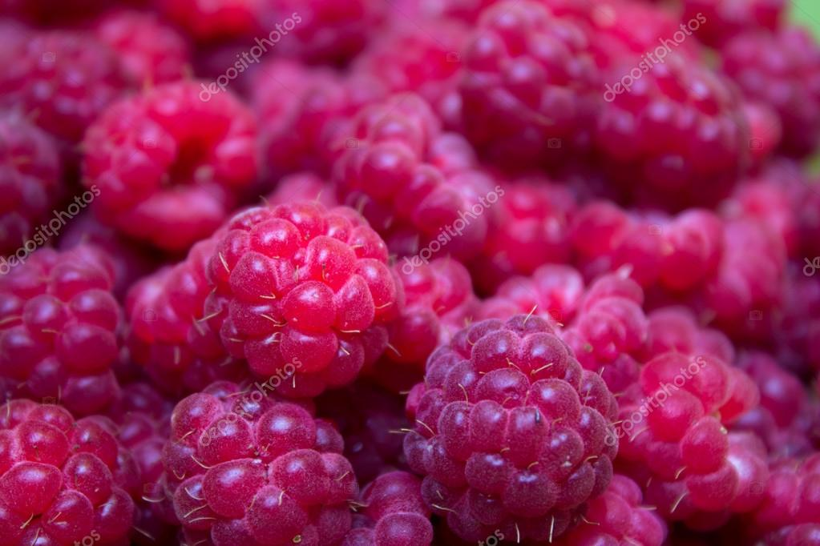
Results-Production
Berry Quality
Yield
Size
Taste
Cull %

Slide 11
Results-Production
Season extension
Protection: “Cannot grow without tunnels”
Risk management: “self-insurance” for crops

Slide 12
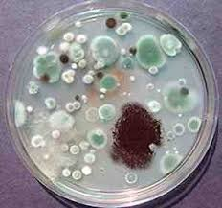
Results-Production
Different Pest pressures
“Petri dish”
More proactive scouting
Predatory mites and lacewings

Slide 13
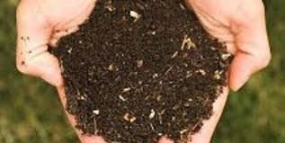
Results-Production
Fertility
More frequent
Soil samples
Tissue samples

Slide 14
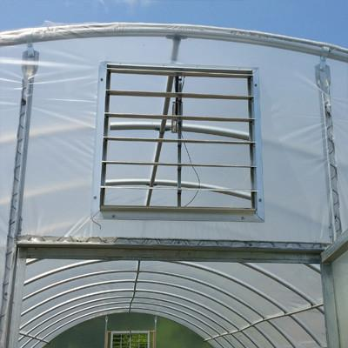
Results-Production
Challenges
Ventilation
Mechanization

Slide 15
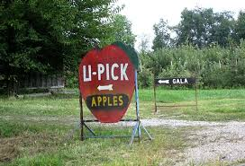
Results-Marketing
Berry quality: size, consistency, quality= “brand”
Extended season piece premium
Attract customers

Slide 16
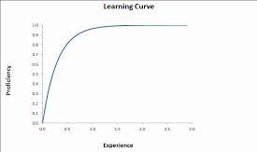
Implications
Start small and grow
Expect a learning curve

Slide 17
Implications
Most likely to succeed
Independent grower
“Local food” demand/markets
Price premiums and value added
Early adopters?

Slide 18
Implications
Most likely to succeed
High acreage
High volume
Highly mechanized

Slide 19
Implications
Dead zone of mid-scale
Too big to be small
Too small to be big

Slide 20
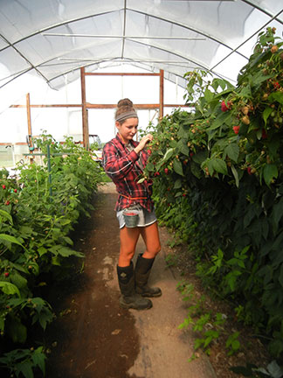
Research needs
Automation
Ventilation
Other?

Slide 21
Discussion
What rang true for you?
How are your experiences different?

Slide 22
Thank you!
david.conner@uvm.edu

