Slide 1
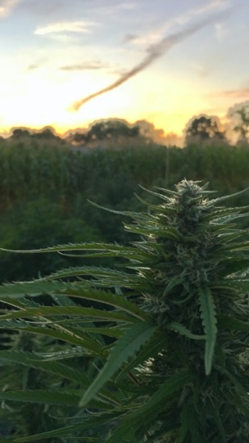
Hemp Production
*mostly for CBD and other major cannabinoids
Dylan Bruce
Circadian Organics / UW-Madison
circadianorganics@gmail.com | dbruce3@wisc.edu

Slide 2
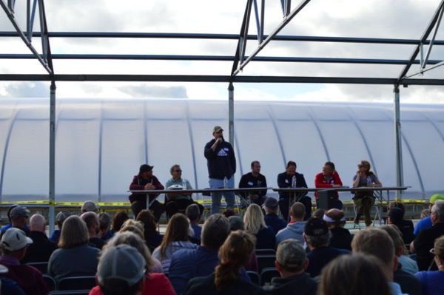
Hemp Extension
Dr. Shelby Ellison
UW-Madison Department of Horticulture
slrepinski@wisc.edu
Dr. Ellison (far right) moderates a marketing panel at the 2019 WI CBD Hemp Field Day

Slide 3
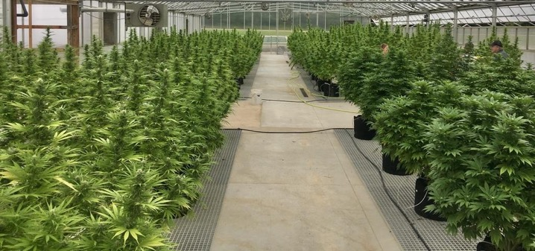
Outline:
Legal Considerations
Risk Management
Setting Up for Success
Field Prep, Layout, and Planting
Fertility Basics + Trial Results
Weed Management
Pest Management
Disease Management
Advanced grower breakout report
Testing Requirements
Harvest Methods
Postharvest Handling and Storage
Processing 101
Marketing and QC - break into groups
Q&A and Looking Forward

Slide 4
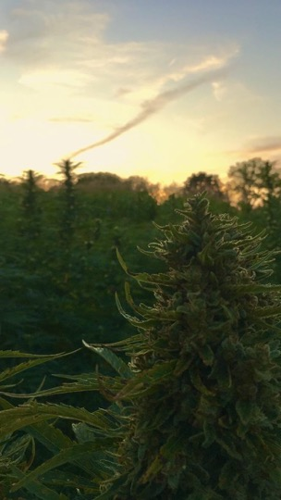
Brief Background + Legal Considerations
Hemp Production for CBD

Slide 5
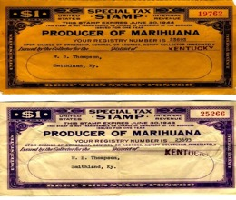
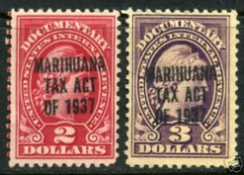
History
Hemp was main textile fiber worldwide until the mid-19th century (replaced by cotton, synthetics )
Between Civil War and WWI most U.S. hemp grown in Kentucky
During WWII (hiatus from illegality) Wisconsin was leading producer
Marijuana Tax Act of 1937
Notes:
Marihuana Tax Act of 1937 defined hemp as a narcotic drug, requiring that farmers growing hemp hold a federal registration and special tax stamp, effectively limiting further production expansion
(Logan Esarey History of Indiana, p.836)

Slide 6
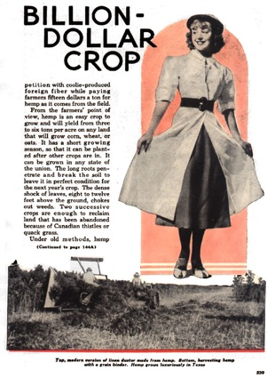
Popular Mechanics, 1938
400,000 acres 1942 to 45
Notes:
written before, but published after the Tax act of 1937
Zero by the 1950s

Slide 7
Regulatory background
1970 Controlled Substance Act
Declared all Cannabis varieties as a schedule one controlled substance - under the regulatory authority of DEA
2014 U.S. Farm Bill - sec. 7606
Industrial hemp can be grown or cultivated for research purposes under agricultural pilot programs – deferred to states
39 states defined hemp as distinct and removed barriers to its production
2018 U.S. Farm Bill - sec. 2667
Removes hemp from the controlled substances and restrictions on cultivation as long as contains no more than 0.3 % THC
Notes:
Add one by one

Slide 8
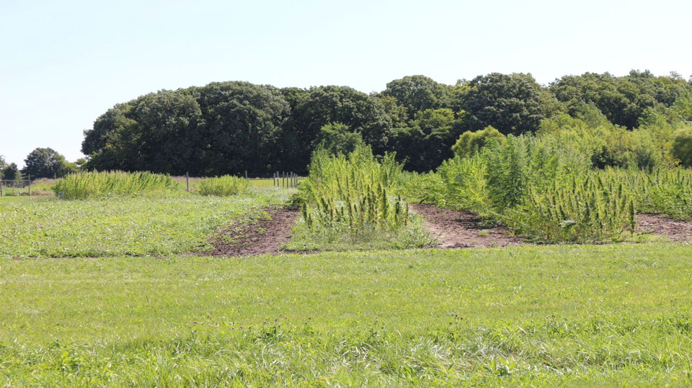
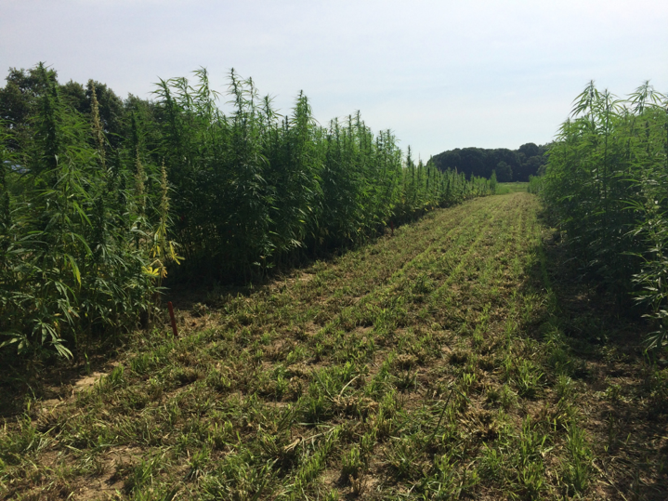
Industrial hemp is low-THC cannabis
•THC 0.3% or below
•Can be grown for:
•Grain
•Fiber
•Cannabinoids such as CBD
Notes:
Typically Cannabis sativa sativa

Slide 9
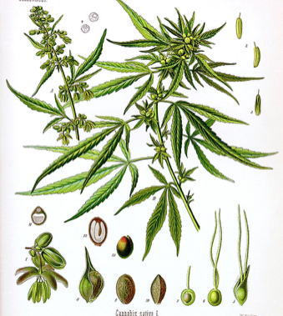
Cannabis sativa L.
Erect, bushy, annual herb
Seed to seed in one year
Dioecious
Males and female flowers are typically on separate plants
Wind pollinated
Photoperiod sensitive
Vegetative >14 hours of light
Reproductive <14 hours of light

Slide 10
Setting Up for Success: Pre-Season Considerations
Hemp Production for CBD

Slide 11
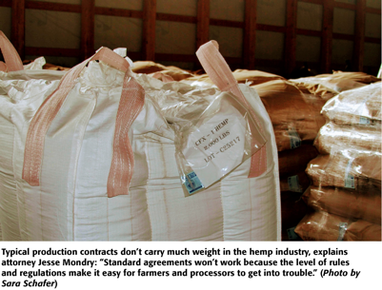
Risk Management and Insurance
Most require a contract
Must have 1+ year hemp growing exp
USDA Crop Insurance Pilot Counties
Whole Farm Revenue Protection
Great option for organic producers
Insures yield*price=revenue
3/15/20 deadline
Insurance for container grown coming in 2021
Make sure you are talking to your banker!
© Ag Professional https://cdn.farmjournal.com/s3fs-public/inline-images/SS%201-min.jpg

Slide 12
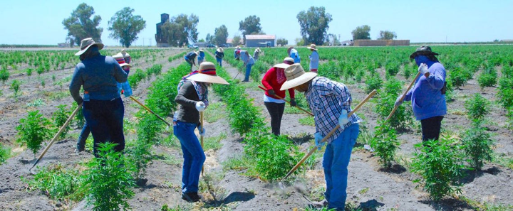
Labor
Most production styles necessitate a lot of hand labor
Key labor choke points:
Planting
Early-mid season weed control
(esp after too tall to cultivate)
Harvest - most labor intensive of all!
Bucking
Will likely need larger crews for harvest than can be sustained the whole year
© The Business Journal https://thebusinessjournal.com/wp-content/uploads/2019/08/Hemp-field-1.jpg

Slide 13
Field Prep, Layout, and Planting
Hemp Production for CBD

Slide 14
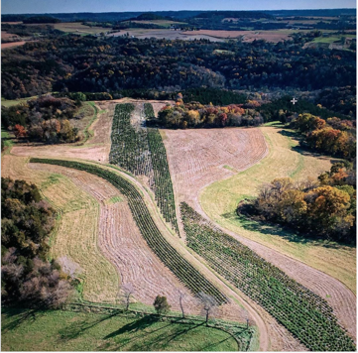
Field Layout
Key considerations:
Proximity to feral hemp populations, grain farmers, other CBD fields
Is it set up for the spacing of my equipment or will new equipment for this set-up be worth it?
Is this planting density recommended for this variety? Recommendations for what climate?
Will I be able to control weeds?
Can I irrigate if needed? Is it worth being able to?
Can I keep an eye on my plants?
How will I harvest?
© Botannicanna Farms, Galena, IL

Slide 15
Field Layout
Before tilling your field or deciding on your layout think through the whole season! Like we’ll do today :)
Key consideration: What is my intended market? Smokable vs biomass
Example Common Planting Layouts:
Between Row | In Row | Population | Market | Weed Control | Benefits
5’ | 5’ | ~1700 | Biomass | Cultivated | Use common equip set up for 30” rows
6’ | 4-5’ | ~1800 | Biomass | Plastic | Narrow setup for plastic
8’+ | 4-8’ | ~680 | Biomass/smokable | Plastic/Cover Crop/Living Mulch | Wider setup for plastic, incl CC, fit a 4’ mower deck

Slide 16
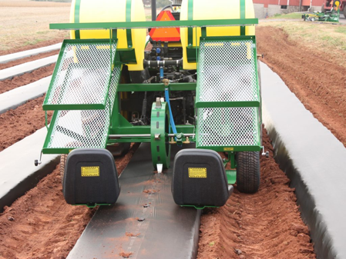
Tillage and Planting
Direct seeded vs transplants
Large seed should work with a variety of planters
Avoid compaction
Consider strip tillage!
Plastic mulch/landscape fabric
Tobacco transplanters
Rainflo/waterwheel
Hand transplant (not as bad as other crops since you are at ~5’ spacing
You don’t need a special hemp transplanter
© Rainflo, Model 1600 Transplanter
Notes:
OK to plant over time range - start some fields earlier

Slide 17
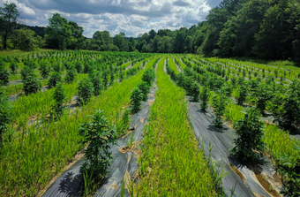
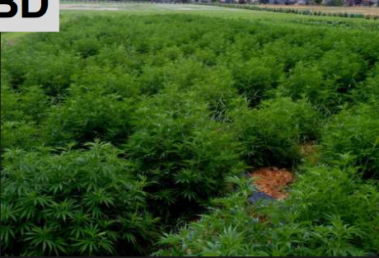

Slide 18
Soil Fertility Basics
For Hemp Production for CBD

Slide 19
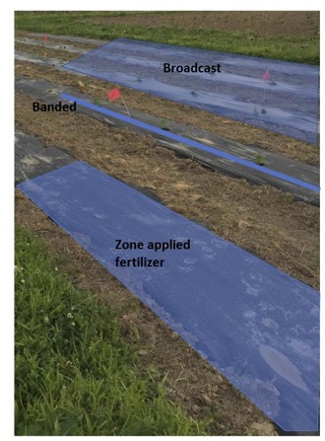
Fertilizer Overview
Test your soil!
Specific recommendations still being developed
What options work best for your equip + scale?
Pre-blended vs custom blends
Broadcasted vs zoned vs banded
Single application vs sidedressed
Green manure options?
Use long term soil building strategies - hemp likes high OM!
Different growth stage, different needs
Early, vegetative growth needs N
Later reproductive stage (flower dev) needs K, P

Slide 20
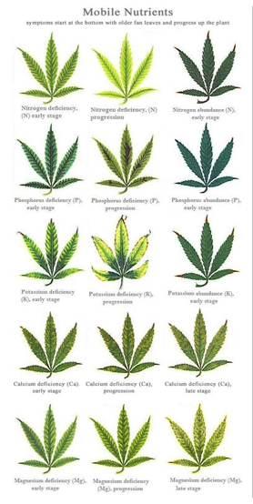
Specific Recommendations are Still Being Developed, but...
pH 6-6.8
Higher N will increase biomass - recommend ~140+/A
Extension recommends 120#/A for fiber/grain
N should be mostly available before flower
P and K depend on soil test results
If unknown, err towards 50+ #P and ~60+#K
If you have depleted/low OM soil consider banding high quality compost
Get by with 2000#/A ~4-3-2 crumble
Should be in the ballpark of other heavy feeding veg crops except more K and S
Notes:
Note that Ca is not a mobile nutrient, so a mistake on this chart.

Slide 21
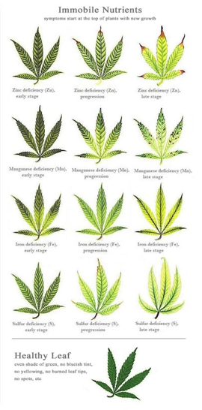
Don’t forget your secondary and micronutrients
Micros are key for successful cannabis production
Ca important as any crop, S more so, but hemp also sensitive to overapplication of S
Overapplication of K can result in difficulty accessing Ca or Mg
EC of 2.0+ will probably result in yield drag
Don’t apply Ca and P at the same time
Kelp meal, azomite good sources of micro

Slide 22
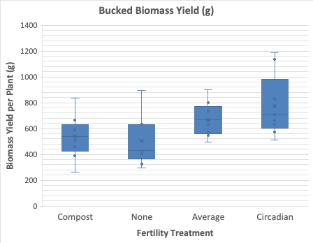
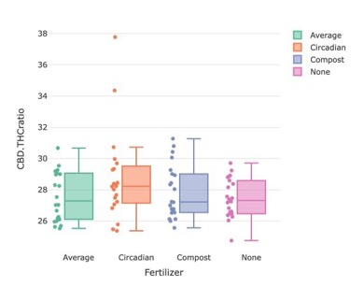
Fertility Trial
Increased N results in more biomass
Increased N does not change CBD:THC ratio
Increased N / “boutique” fertilizer blends do not significantly* change CBD accumulation

Slide 23
Plant Management and Sexing
💖management for the better half💖

Slide 24
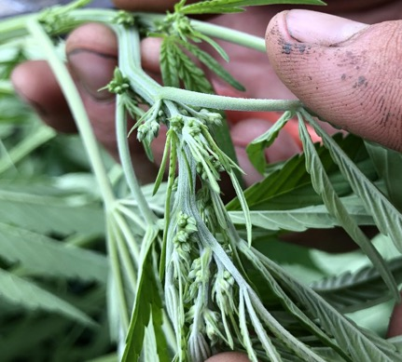
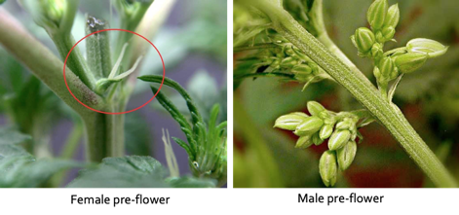
Identifying Male vs Female Preflowers
Pre-flowers at their nodes
By the sixth week, you should be able to find the pre-flowers and confidently determine the sex of your plant
Remove male and hermaphroditic plants
Males generally more vigorous, more upright growth habit

Slide 25
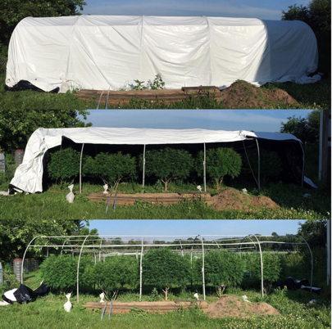
Quality Control Strategies - Light Deprivation
“Light Dep”
Tricks plant into earlier flowering/finish
Avoid wet/cold fall (disease/mold)
More likely to take plants to market maturity for smokable flower
Lots of work!!
© Midwest Cultivars, LLC

Slide 26
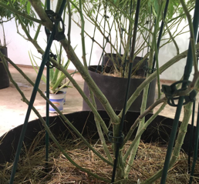
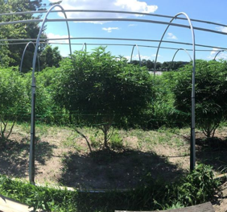
Quality Control Strategies - Topping + Pruning
Topping increases branching
More “top” colas, increase yield in wide spacing layouts
May make more prone to lodging
Pruning improves airflow
Especially bottom branches
Less disease
More sunlight to flowers improves structure and volume > more marketable flower
© Midwest Cultivars, LLC

Slide 27
Weed, Pest, and Disease Management
Hemp Production for CBD

Slide 28
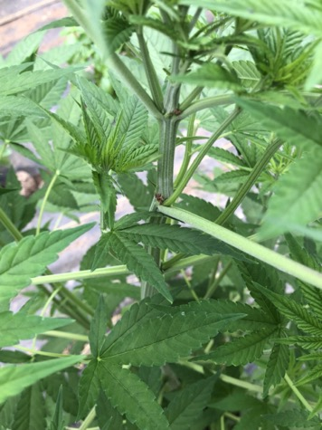
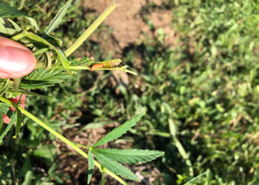
Pest Management - insects
Stalk borers- European corn borer, Eurasian hemp borer
Corn earworm
Aphids, mites, thrips
Insects that chew leaves of the plant (defoliators) – caterpillars, beetles, grasshoppers, cutworms, plant bugs
Eurasian hemp borer
Notes:
Big challenges based in legal uncertainties affecting the crop
Hemp is many different kinds of crops and pest management issues will vary by production method and end use - Whitney Cranshaw –CSU
When hemp was last produced in major quantities (WWII) only one insect mentioned as significant to production (Willsie et al. 1942) - European corn borer

Slide 29
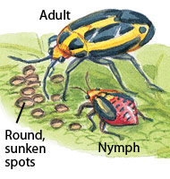
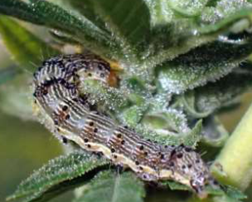
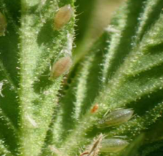
Pest Management - insects
Stalk borers- European corn borer, Eurasian hemp borer
Corn earworm
Aphids, mites, thrips
Insects that chew leaves of the plant (defoliators) – caterpillars, beetles, grasshoppers, cutworms, plant bugs
Four Lined Plant Bug (PC: gardengate magazine)
Cut worm
Cannabis aphid
Notes:
Big challenges based in legal uncertainties affecting the crop
Hemp is many different kinds of crops and pest management issues will vary by production method and end use - Whitney Cranshaw –CSU
When hemp was last produced in major quantities (WWII) only one insect mentioned as significant to production (Willsie et al. 1942) - European corn borer

Slide 30
Pest Management - insects
Biopesticides, soaps, and oils
Monitor visually and with sticky traps
Prune infested plants
Caterpillars, etc. removed by hand picking
Insectary plants grown around the perimeter can provide beneficial insects – green lacewings, syrphid flies, collops beetle, damsel bugs
No labeled synthetic herbicides or pesticides
Can use some organic compounds
Please be sure to go to: https://datcp.wi.gov/Documents/IHPesticides.pdf to make sure product is approved

Slide 31
Pest Management - insects
Important resources:
https://hempinsects.agsci.colostate.edu
JM Parkland
Cannabis/marijuana cultivation resources

Slide 32
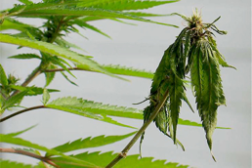
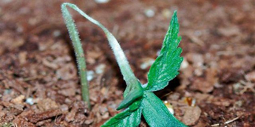
Disease Management
Fusarium wilt
More humid climate than west - challenging
Powdery mildew (Podosphaera macularis)
Botryis/Gray mold – “bud rot”, inside flowers causing rot from inside out - often because of insects
Septoria/Blight/Leaf Spot - Same genus, dif. species
Sclerotinia, Pythium and Fusarium - similar to what you’re familiar with in vegetables
Pythium
© Blue Sky Organics

Slide 33
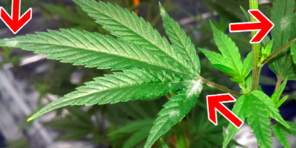
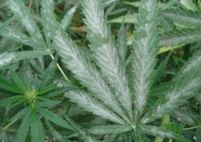
Disease Management - Powdery Mildew
Improve airflow and help reduce establishment and spread of powdery mildew
Wide plant spacing
Selective pruning during the vegetative stage
Preventative sprays of potassium bicarbonate (GreenCure®)
Start 1 week after transplant, every other week during vegetative cycle and up to first 2-3 weeks of flower.
Probable contributing factors
Excessive fertility, low light, excessive soil moisture, moderate temps (for instance, PM on hops prefers 64-70F).

Slide 34
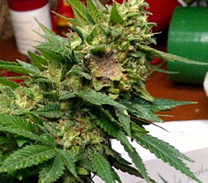
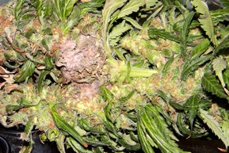
Disease Management - Botrytis
Improve airflow and help reduce establishment
Wide plant spacing
Selective pruning during the flowering stage
Clonostachys rosea
Use in potting soil or at planting
Spray at start of flowering and possibly again 2 weeks later
Probable contributing factors
Excessive fertility, low light, excessive soil moisture, moderate temps (for instance, PM on hops prefers 64-70F).
Dry quickly
Remove infected material from storage

Slide 35
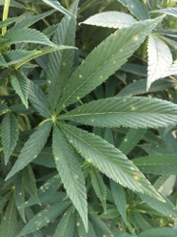
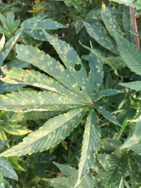
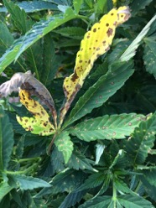
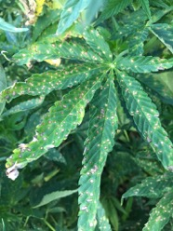
Disease Management - Septoria
Improve airflow and help reduce establishment and spread of powdery mildew
Wide plant spacing
Selective pruning during the vegetative stage
Preventative sprays of potassium bicarbonate (GreenCure®)
Start 1 week after transplant, every other week during vegetative cycle and up to first 2-3 weeks of flower.
Probable contributing factors
Excessive fertility, low light, excessive soil moisture

Slide 36
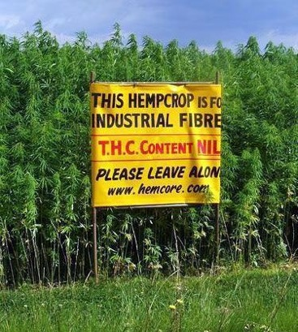
Pest Management - Vertebrates
Deer, humans, rabbits, mice, moles
Fences and other barriers
Traps
Cameras
Signs

Slide 37
Pest management key points
Scout regularly
Correctly identify pests
Assess spatial and temporal distribution
Cultural practices and biological control
Select appropriate protection strategies
Keep detailed records to track population trends
Sanitation
Contact your state entomologist/pathologist

Slide 38
Additional Resources
https://hempinsects.agsci.colostate.edu/hemp-insects-text/
https://datcp.wi.gov/Documents/IHPesticides.pdf
http://labs.russell.wisc.edu/insectlab/contact-us/
https://pddc.wisc.edu/
https://datcpservices.wisconsin.gov/pb/pdf/07-18-19.pdf

Slide 39
Testing Requirements and Methods
Top 3 tips to not lose your crop:
Test
Test
Test

Slide 40
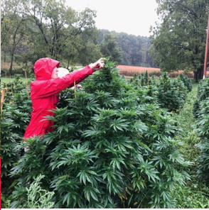
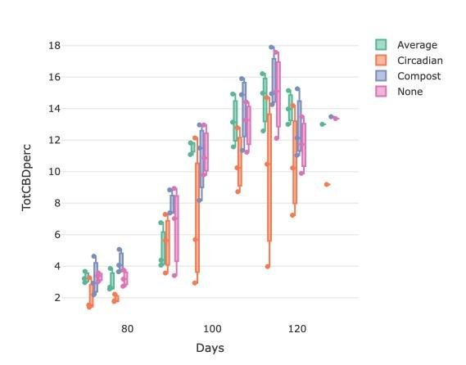
Test Early, Test Often
© Mt Horeb Hemp
DATCP 30-day preharvest test
DATCP asks that you harvest within 10 days of test results being delivered
Monitor development with pre-harvest testing
Start by week 5 after preflowers
Many labs offer preharvest testing

Slide 41
Cannabinoid Testing
High Performance Liquid Chromatography (HPLC)
Cannabis flower is dried and mixed with a solvent to extract cannabinoids
The solvent is pumped through a column that separates the cannabinoids based on their chemical properties
Cannabinoids that are attracted to the material inside the column will travel slower and reach the detector at the end of the column later
The detected compounds are quantified using standards of known concentrations

Slide 42
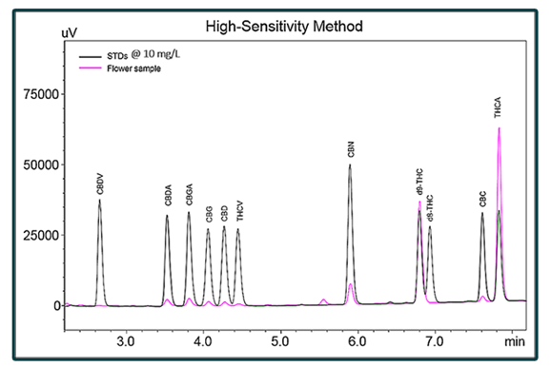
Cannabinoid Testing
DATCP calculates Total THC as delta9‐THC + ​(THCA *0.877); round down so 0.399 => 0.3%

Slide 43
Certificate of Analysis

Slide 44
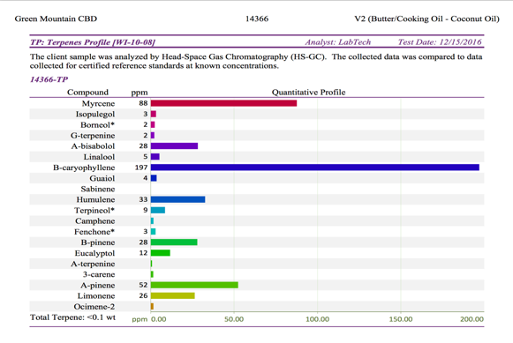
Additional testing
Heavy Metals Analysis
Lead, Arsenic, Mercury
Aflatoxins, Mycotoxins & Pesticides
Terpenes
Cannabis Microbial Testing

Slide 45
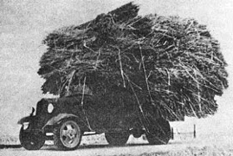
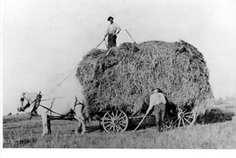
Harvest
Get ready for a truckload of work
… and probably get your hay wagons ready too

Slide 46
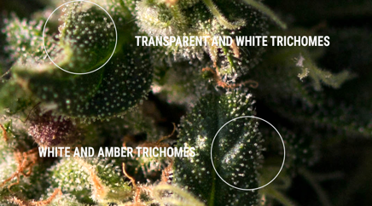
Harvest Overview
Visual clues on the hemp bud - trichomes on the hemp bud shift from clear to milky white and pistils die back
Timing: Mid Sept – Mid October
Harvestable parts:
Biomass – stems, leaves, flower buds – least labor intensive, least CBD
Flower – medium labor, high CBD
Trimmed flower – most labor, most CBD
Contact DATCP 30 days before harvest
Fit for Commerce Certificate
© Royal Queen Seeds https://www.royalqueenseeds.com/img/cms/NOT-READY-AND-READY-TRICHOMES.jpg

Slide 47
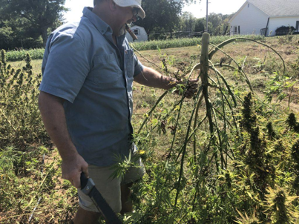
Step 1 - Cut Plants
Methods vary based on acreage, end market and capacity for drying
Cut whole at the base and moved to a sheltered location for further breakdown.
Bucked into smaller sections for quicker drying
Broken all the way down to individual buds for wet trimming
https://www.instagram.com/p/B2gvTExFQrn/
CREDIT LIAM NIEMEYER / OHIO VALLEY RESOURCE https://mediad.publicbroadcasting.net/p/wkms/files/styles/x_large/public/201910/hemp_harvest.jpg

Slide 48
Step 2 - Hanging/Drying
Whole plants
Branches
Leave hook from node to hang from line
Hang from cable, rope, snow fence
Ensure airflow
Consider removing fan leaves
Biomass can be dried as quickly as possible
Forced air, heat + dehumidifier
Boutique/smokable:
most of the moisture within the first 3 days at 68˚F and RH of 55%, after which the temperature should be dropped to around 64˚ and RH to 50% to prevent flowers from drying too quickly. Branch sections of 1’-2’ are good. For best results, the remainder of the drying process should happen over the following 10-14 days.
© Philadelphia Inquirer

Slide 49
Hanging/Drying Considerations
Large ventilated barns or specialized drying chambers or equipment - under roof, out of direct sunlight
seed or tobacco drying units
Drying facilities that are suitable for production of a food or medical product
clean, dry floors, no insect or animal infestation (birds nesting overhead) which could contaminate the drying product
Hemp drying machines can dry larger volumes of plant material
use warm, dry air and movement to speed up drying
excessive heat may degrade cannabinoids and WILL vaporize terpenes
The ol’ tobacco shed probably won’t cut it...

Slide 50
Step 3 - “Bucking”
Stripping buds from stem
Much easier when dry
Many machines marketed
Hand bucking as fast as any machines once dry
Must be extremely gentle with boutique/smokable: clip by hand
© Christopher Ross, https://www.youtube.com/watch?v=mRcIHFTsA0w

Slide 51
Post-Harvest Handling and Storage
Important for accessing higher prices

Slide 52
Trimming
Hand or machine trimming
Wet vs dry trim
Either way, labor intensive
Especially by hand
This is a processing activity - must be licensed if trimming other farmer’s crops
Will ‘concentrate’ cannabinoids

Slide 53
Storage Considerations
Do not store moist buds > molds.
Product quality loss from abrasion or impact when very dry or very cold.
Trichomes become brittle and will easily break off
Temperature and humidity fluctuations = uneven drying.
What may seem like a dry product may harbor moisture on the interior + cause mold/fermentation in storage.
Once desired moisture level is achieved (10%-15%) store in sealed/dry, cool and dark location.
© Midwest Cultivars, LLC

Slide 54
Processing 101 - What the Grower Needs to Know
Hemp Production for CBD

Slide 55
Processing
Once harvested, dried and tested hemp is ready to be processed
Can extract CBD rich oil from flower or biomass material
CBD is further refined to produce CBD distillate or isolate
Sold or processed into finished CBD products such as oil tinctures or lotions

Slide 56
CBD Extraction
CO₂ - uses controlled pressure and heat
Expensive equipment, steep operational learning curve
End product is safe, potent, and free of chlorophyll
Ethanol – addition of solvent
High-grade grain alcohol extracts cannabinoids but destroys potentially beneficial plant waxes
Butane
Relatively low equipment and running cost but can be dangerous
Produces flavorful extracts with higher terpene content than can be achieved by CO₂ extraction
Olive Oil
Can extract cannabis oils however it is perishable and should be stored in a cool, dark place
Notes:
Grinding increases surface area making it easier and more efficient to extract CBD and other cannabinoids
When extraction is complete, a series of fractioned cannabinoid and terpene extracts will be ready for further processing. The extracts contain all of the necessary active ingredients that will be used in the final products. At this stage the extract requires refinement before it is bioavailable as a medicine or finished product. At this stage in processing the extract is referred to as raw crude.

Slide 57
Full Spectrum Oil
Contains wide range of cannabinoids naturally present in hemp, like CBD, CBN, and CBL
Also contains aromatic and beneficial terpenes
Because there is no further refinement, full spectrum oil will also contain trace amounts of THC
May provide a greater effect than CBD alone as all the cannabinoids have been shown to work better together in what is known as the “entourage effect”

Slide 58
Further processing steps
Dewaxing
Filtration
Solvent removal
Distillation
Isolation
Notes:
Dewaxing: Raw crude from extraction process contains waxes, plant pigments and other impurities – need to be removed. To begin this process a food grade solvent such as ethanol is added to the raw crude which facilitates the precipitation of undesired waxes present due to the solubility selectivity determined at extraction. Removal of these waxes will increase purity and concentration of cannabinoids. Upon chilling in a freezer, waxes begin to precipitate and dewaxing is performed via filtration. By breaking bonds of fatty plant matter, the separation and removal of waxes from the wintered material is conducted. Dewaxing stabilizes the cannabinoid solution, preparing for successful formulation. Dewaxing purifies the cannabinoid solution, allowing for a more potent final oil. For successful dewaxing, the polar substances within the solution must be separated from the non-polar. The bi-product of dewaxing is a hemp wax. This wax contains little to no cannabinoids. In some applications, the wax may be saved for use in products. In most applications, the wax is destroyed. Time, temperature, and the amount of waxes present will determine the efficiency of wax removal. The ultimate goal of dewaxing is always to eliminate all waxes from the solution. The less waxes that are present, the more stable and potent the final oil will be. With heavy loads, this will require multiple stages of dewaxing and filtration with intervals sufficient to allow precipitation of waxes.
Filtration: Once waxes have been successfully separated and the wintered material has reached the temperature target, the solution will be filtered. Filtration is the final step in dewaxing.
During dewaxing, the non-active components of the solution are separated. Cannabinoids are kept suspended in the solvent due to temperature and mixing procedures. By filtering the wintered solution the waxes may be removed, leaving the cannabinoids dissolved within the solvent. To perform filtration, the supernatant is transferred to a clean vessel through a food grade filtration system. The type of filtration used is dependant on the workability of the current solution, and is determined by an experienced Processing Technician. Types of filtration include gravity filtration, vacuum filtration, pour-through filtration, and wintered filtration. The goal of filtration is for the properly chilled and prepared solution to pass through porous media to 0.2µm threshold without remaining waxes. After sufficient intervals to stabilize the temperature, a sample will be drawn and evaluated for any remaining waxes. Dewaxing success is dependant on experience of Processing Technician and the available equipment. Filtration will continue through several cycles until testing proves the process has reached maximum success. Use of a centrifuge will greatly increase success of filtration. Filtration can take anywhere from 48 hours to 5 days, depending on skill of Processing Technician and available equipment.
Solvent Removal: Following filtration of waxes, pure cannabinoids remain suspended in the food grade solvent added during the Dissolving phase. The solvent added to facilitate dewaxing now needs to be removed. Removal of the solvent is performed using careful vacuum and temperature control optimized to limit any degradation of the target cannabinoid compounds. Cannabinoids are extremely sensitive to heat, and incorrect temperature control will destroy the purity and strength of the extract. The most often used instrument for solvent removal is a rotary evaporator. The rotary evaporator must be furnished with the correct accessories to properly conduct solvent removal with cannabis. These accessories include things like a vacuum pump, a bulb specified to the proper size and material, and heating bath solvent capable of meeting necessary heat settings. The rotary evaporator will be set to carefully chosen specifications to pull off the solvent, while protecting cannabinoids and increasing purity of the final material. When done correctly, the solvent will be recovered at a purity of 90% or greater. In these cases, the solvent may be re-used for future processes, saving the company large amounts of money and saving storage space. Storage and recovery of solvents is often a major part of the labor, cost and floorspace allocated to extraction and refinement processes for hemp oil, and is a common reason why companies choose CO2 extraction over ethanol extraction due to the massive volumes of ethanol which must be recovered and stored, which represent an explosion risk.
Distillation: Regardless of care taken during previous steps of hemp processing to extract CBD oil, impurities are inevitable and non-preventable, even by the most skilled techican. To create the purest extract possible, a final distillation is completed which, when properly conducted, serves many important purposes including. Removal of impurities. Isolation of terpenes, a vital component to formulation of effective cannabis medicine. Decarboxylation of cannabinoids for oral bioavailability. Concentration and purification of cannabinoids – predominantly CBD but also THC and minor cannabinoids such as CBG, CBC, CBN and others. Short Path Distillation is the single most important and yet precarious of all the purification steps. Short Path Distillation should only be conducted by an experienced Processing Technician. Conducting Short Path Distillation without proper training and experience can lead to destruction of terpenes and cannabinoids.
During Short Path Distillation, a combination of temperature, circulation, and vacuum manipulation are used to isolate and separate different cannabis component extracts. A Short Path Distillation system is usually built piece-by-piece for optimal functionality. Rhizo Sciences is versed in these distillation systems and will source and install Short Path components which are appropriate for the projected throughput of the facility. Proper use of Short Path Distillation can yield anywhere from 70% cannabinoids to 95%, depending on the material, the equipment, and the technician expertise. The material which results from Short Path Distillation is called “CBD distillate”.
Isolation: Hemp Derived CBD Isolate is purified 99.5%+ CBD and appears as white a crystal, powder or granules. Isolation of cannabidiol is a multistep technical process requiring specialised equipment and experienced staff. Most CBD isolate is produced using a combination of distillation and chromatography to produce a high purity liquid (80%+ to 90%). At this purity, CBD crystallises spontaneously to form crystals of almost pure CBD. To separate these from the oil they are often precipitated out of solution from a solvent such as pentane or supercritical CO2.
Because chromatography and solvent precipitation both rely on complex solvent mixtures and recovery, and may require multiple passes in order to achieve high levels of purification (99.5% to 99.9%).

Slide 59
CBD Distillate
Further processed compounds from full spectrum oil (crude)
Distillate typically contains around 80% CBD, includes minor cannabinoids, terpenes and other plants oils and extracts
because distillate still contains other cannabinoids and terpenes often considered a broad spectrum product

Slide 60
CBD Isolate
Further refined product from distillate
purified cannabidiol white, granular, crystals comprising up to 99.5% or more of CBD
Crude -> Distillate -> Isolate

Slide 61
Toll Processing agreements
Growers sell to processors
Growers pay processors and get products back
Processing CBD split contract
split of 50:50 (or some other agreed upon amount) where processor extracts and returns half of your sample and keeps the other half as payment for the processing services

Slide 62
Marketing and Quality Control
101 reasons to get a contract

Slide 63
Markets Overview
Biomass > extraction
Tincture
Supplements
Oils/salves/lotions
Smokable flower / “Boutique”
Trimmed flower
Pre-rolled ‘joints’
‘Hemparettes’ / pre-rolled cigarettes
Smokable flower is an agricultural product = less regulation
Cosmetics 2nd least regulation
Tinctures/supplements gray area
Food/’edibles’ are illegal
CBD is adulterant
© Amsterdam Organics

Slide 64
Market Projections
2015 - US hemp-based product sales totaled $573 million
2016 - sales grew to $688 million
2017 - sales reached $820 million
2018 – sales reach $1.1 billion
2019 - ???
Include food products, industrial applications, fiber products, and CBD
Brightfield Group projects $20B+ CBD market
Many have unsold product from last year
The market is anyone’s guess
Look out for results of a survey coming soon from UW-Extension

Slide 65
Grain and Fiber Hemp

Slide 66
Plant grain at your own risk
https://static.producer.com/wp-content/uploads/2017/02/22_4col_FILE-PHOTO-RKA072815_HEMP_PLOT31.jpg

Slide 67
UW cultivar and nitrogen research
Potential for grain and fiber hemp
Variety | Seeding Rate (lb/acre) | Nitrogen Rate (lb/acre)
X-59 | 20 | 0
CRS-1 | 30 | 60
 | 40 | 120
Planted on 7.5” row spacing at ½ inch, Arlington and Chippewa Falls (previous: soybean)
Planted June 6th (Arlington) and June 11th (Chippewa Falls), Harvested September 9th, 16th (Arlington) and 13th (Chippewa Falls)

Slide 68
Variety | Average Seeds/acre | Germ Rate % | Average Seeds/lb | Usage | Origin | Cultivar Provider
Anka | 942,923 | 80 | 27,913 | Dual-Use | Canada | Valley Bio
CFX-1 | 984,194 | 80 | 26,219 | Grain | Canada | Hemp Genetics International
CFX-2 | 844,472 | 85 | 26,557 | Grain | Canada | Hemp Genetics International
CRS-1 | 910,933 | 84 | 26,635 | Grain | Canada | Hemp Genetics International
FEDORA 17 | 770,176 | 96 | 25,949 | Grain | France | IHemp Farms
FELINA 32 | 864,762 | 93 | 28,799 | Grain | Europe | Terreslnovia, Thiverval-Grignon
FUTURA 75 | 943,201 | 69 | 24,089 | Fiber / CBD | Europe | IHemp Farms
GRANDI | 881,852 | 88 | 28,708 | Grain | Canada | Hemp Genetics International
HLESIA | 765,723 | 84 | 23,811 | Unknown | Ukraine | Unknown
HLIANA | 753,319 | 90 | 25,088 | Unknown | Ukraine | Unknown
HLUKHOVSKII | 836,150 | 85 | 26,295 | Unknown | Ukraine | Unknown
KATANI | 935,065 | 84 | 29,076 | Grain | Canada | Hemp Genetics International
PICOLO | 969,408 | 83 | 29,783 | Grain | Canada | Hemp Genetics International
USO 31 | 848,598 | 92 | 28,261 | Grain | Ukraine / Germany | IHemp Farms
X-59 | 826,675 | 86 | 26,295 | Grain | Canada / Wisconsin | Legacy Hemp LLC

Slide 69
Emergence
CRS-1 appeared more vigorous than X-59 throughout most of the growing season
Plots along the edges of the field appeared weedier than those towards the inside
Plants grew and flowered much quicker than anticipated
Average plot height doubled week to week from 6/24 – 7/15
Plots began to flower shortly after the summer solstice (6/21/19)
20 lbs. ac⁻¹
30 lbs. ac⁻¹
40 lbs. ac⁻¹
CRS-1
X-59

Slide 70
Preliminary data – not for publishing

Slide 71
Preliminary data – not for publishing

Slide 72
Preliminary data – not for publishing

Slide 73
Preliminary data – not for publishing

Slide 74
Preliminary data – not for publishing

