Slide 1
The WiBee App: A new tool to explore wild bee pollinators on your farm
Katy Thostenson, Hannah Gaines Day, Jeremy Hemberger, Claudio Gratton

Slide 2
What is WiBee: The Wisconsin Wild Bee App?
WiBee is a citizen science smartphone app designed for growers to survey the bees visiting your blooming crops.
Conduct simple 5 minute bee surveys and track the pollinators visiting your crops over time.
Collect data and contribute to pollinator science and our understanding of Wisconsin’s wild bee communities!

Slide 3
Thank you growers for your input!
Atoms to Apples
Brightonwoods Orchard
Door Creek Orchard
Ela Orchard
Gwenyn Hill Farm
Hafs Road Orchard
IPM Institute of North America
Lapacek’s Orchard
Munchkey Apples
Pleasant Springs Orchard
Ten Eyck Orchard
The Apple Hut
The WiBee App was developed by Dan Imhoff, Caracal Inc.
Funding for the program was provided by a Baldwin Wisconsin Idea Endowment grant and Gwenyn Hill Farm

Slide 4
1
Why are wild bees important?
2
Why do we need citizen science?
3
How does the WiBee app work?

Slide 5
Squash bee
Photo by Maddy Vierbuchen
1
Why are wild bees important?

Slide 6
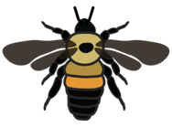
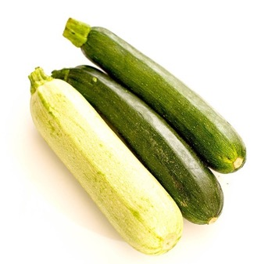
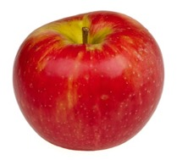
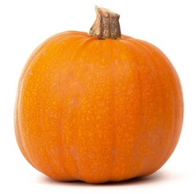
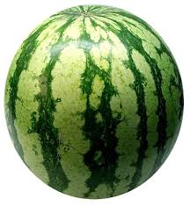
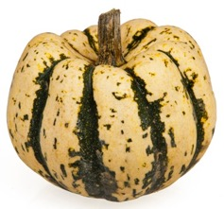
35% of our crop species and 85% of all flowering plants depend on pollinators
Notes:
Bees are also crucial to Wisconsin’s ecosystems, foraging on and pollinating 85% of all flowering plants.

Slide 7
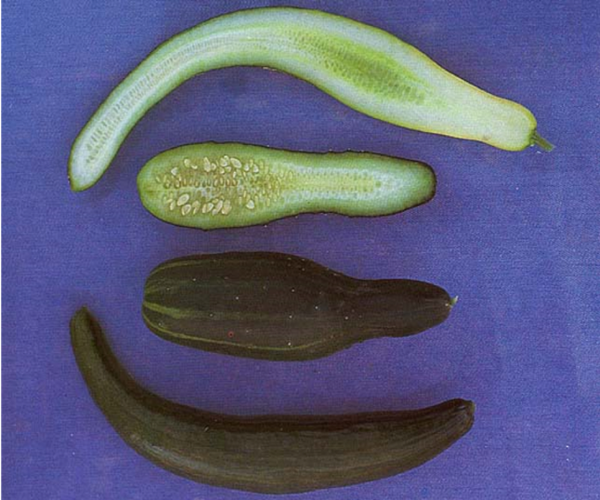
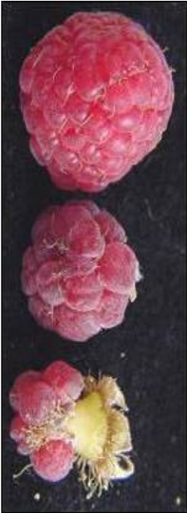
Poor pollination = Poor fruit set and quality
Notes:
Poor pollination can lead to poor fruit set and poor fruit quality.

Slide 8
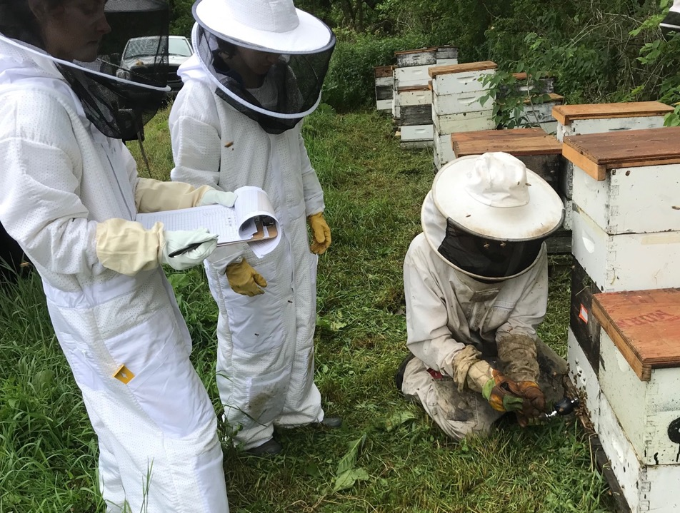

Slide 9
We have one species of honey bee (Apis mellifera) in Wisconsin. It’s not a native bee.

Slide 10
Photo by Maddy Vierbuchen
Honey bees are generalist foragers.
A single hive can have 60,000 bees.

Slide 12
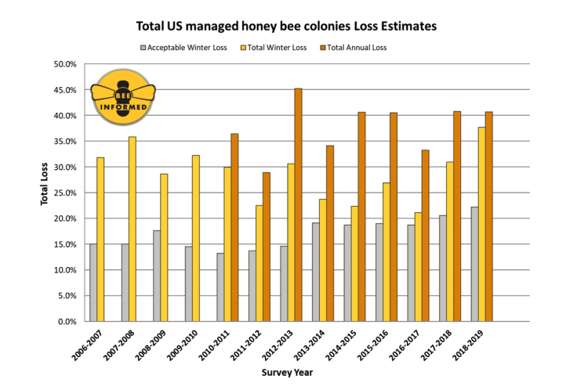
Beekeepers’ high annual honey bee colony losses can lead to higher hive rental costs for growers
Chart based on data from an annual survey of beekeepers (Bee Informed Partnership)
Notes:
There are many causes, including pesticide use, varroa mites, disease, loss of habitat and floral resources.
This is all affecting wild bee populations as well, yet there is strength in diversity.

Slide 13
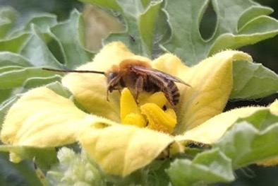
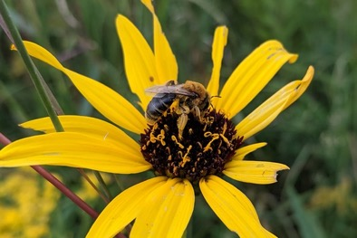
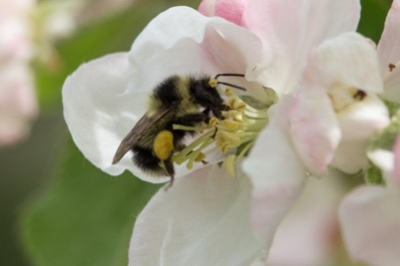
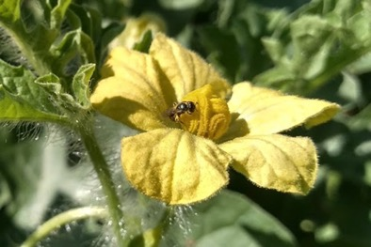
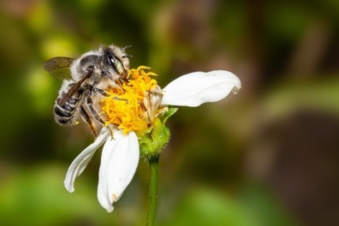
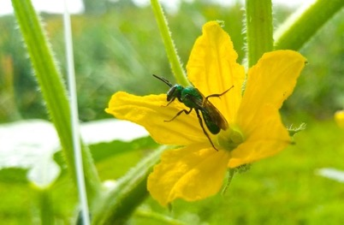
Wisconsin has over 400 species of native, wild bees.

Slide 14
A diverse and abundant wild bee community provides these benefits:
Active earlier in season and in cooler temps
Buzz pollinate
Deposit more pollen per visit compared to honey bee
Less susceptible to honey bee disease
Photo by Flickr user coniferconifer

Slide 15
Can I rely on wild bees for pollination instead of honey bees?

Slide 16
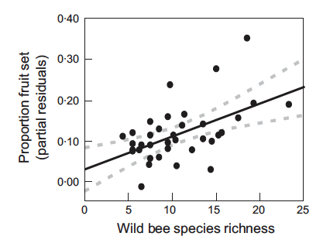
Fruit set increases with increasing wild bee species, regardless of honey bees

Slide 17
Honey bees, like wild bees, are influenced by non-crop areas in the nearby landscape
Notes:
“We collected historical (2000–2011) data on yield and honey bee hive stocking density from 38 commercial cranberry growers in central Wisconsin. Using mixed- model regression analyses we found that cranberry yield was strongly, positively correlated with hive density but this effect diminished as the proportion of the surrounding landscape in woodland increased. Thus, at cranberry marshes in low-woodland landscapes (e.g., <42% woodland within 1 km), increasing the density of honey bees increased yields by about1000 kg/hive, while cranberry marshes in high woodland landscapes saw no effect of adding honey bees. These results suggest that honey bees, like wild bees, are influenced by non-crop areas in the surrounding landscape and that landscape context should be considered when making management recommendations for the use of honey bees for crop pollination.”

Slide 18
Our solution: Develop a grower citizen science tool to expand our data to model wild bee pollination.

Slide 19
2
Why do we need citizen science?

Slide 20
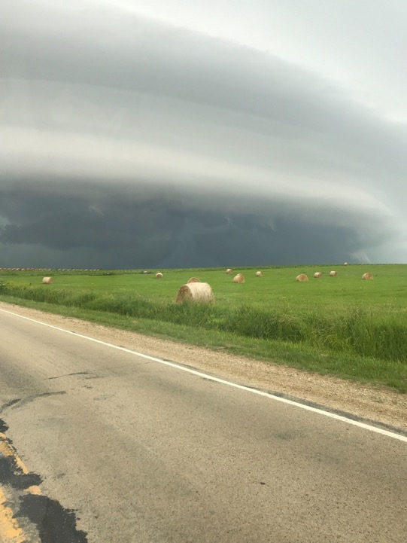
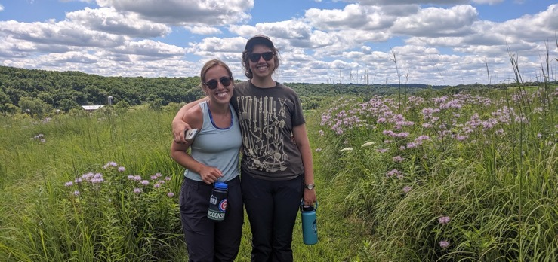
We need your help to collect more data:

Slide 21
Bee communities vary at a local farm level:
Photo by Gilles San Martin (Flickr)
Notes:
Kennedy abstract results: “Bee abundance and richness were higher in diversified and organic fields and in landscapes
comprising more high-quality habitats; bee richness on conventional fields with low diversity benefited
most from high-quality surrounding land cover. Landscape configuration effects were weak. Bee
responses varied slightly by biome. Our synthesis reveals that pollinator persistence will depend on both
the maintenance of high-quality habitats around farms and on local management practices that may offset
impacts of intensive monoculture agriculture.”

Slide 22
3
How does the WiBee app work?

Slide 23
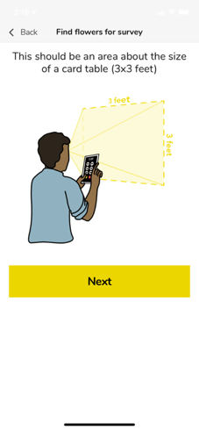
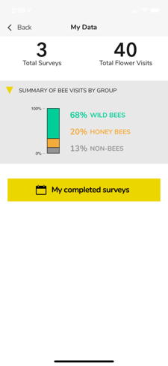
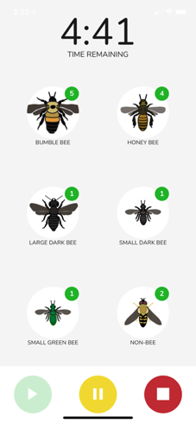
WiBee: The Wisconsin Wild Bee App

Slide 24
Complete 5 minute bee surveys
View your data in real-time
Notes:
It’s very simple!

Slide 25
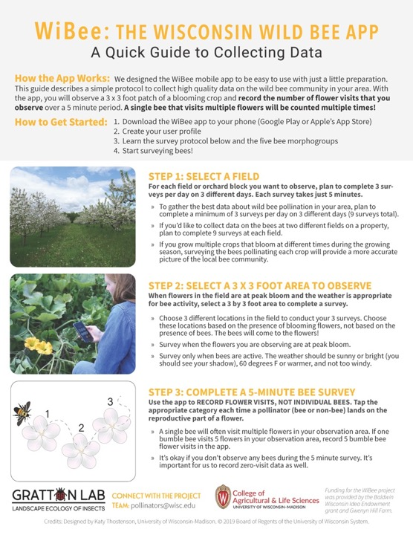
For tips on collecting data, read our one-page guide on our website
www.pollinators.wisc.edu/wibee

Slide 26
WiBee: The Wisconsin Wild Bee App
Bumble bees
Honey bees
Large dark bees
Small dark bees
Green bees
Non-bees (e.g. flies, wasps)

Slide 27
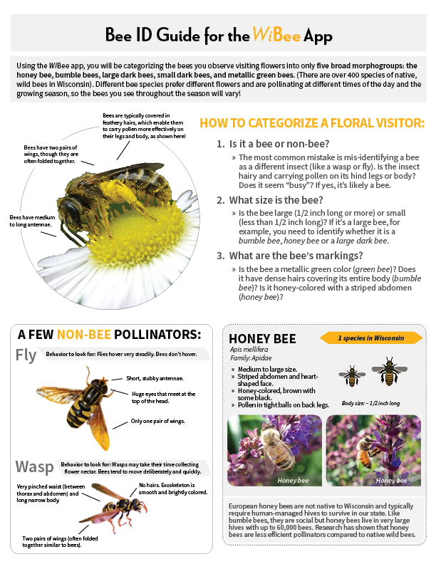
Learn to identify bees with our two-page guide or with ID pages on our website
www.pollinators.wisc.edu/wibee

Slide 29
Find a 3x3 foot area to observe:

Slide 30
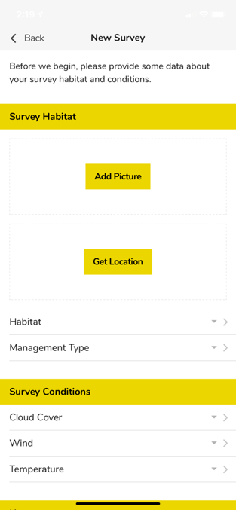
Describe your survey habitat and conditions:

Slide 31
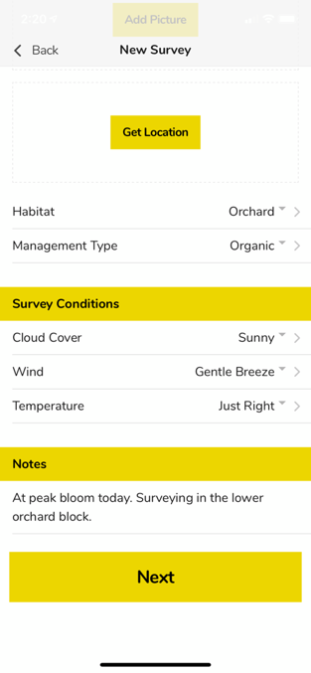
Notes:
The natural habitat on and around your farm sustain your local wild bee community – that’s why we include the option to observe prairie and woodlands.
Crop type: you will be able to indicate what crop species you are observing – it’s being programmed now.

Slide 32
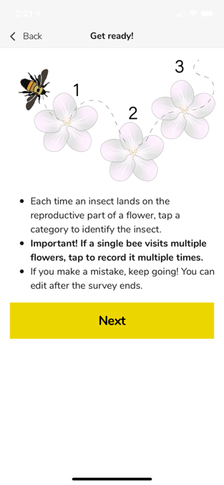
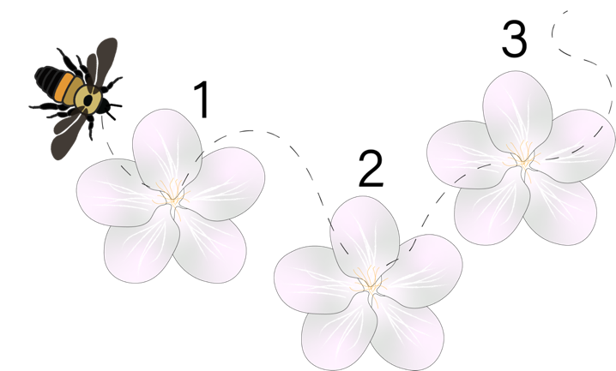

Slide 33
Observe and record flower visits for 5 mins:

Slide 34
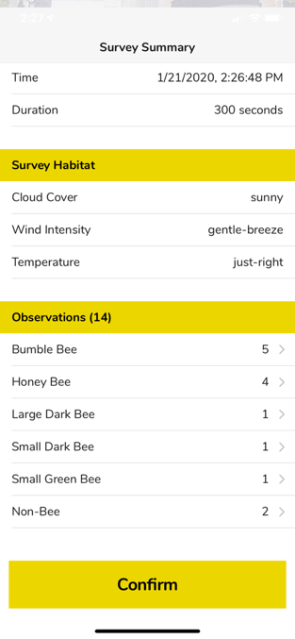
Fix any ID mistakes and submit your survey:

Slide 35
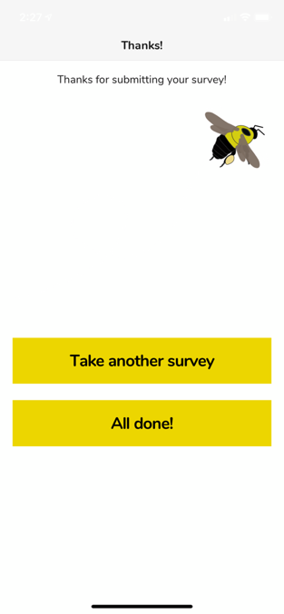
Complete 3 surveys a day, for 3 days:

Slide 36
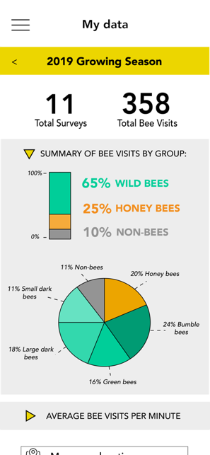
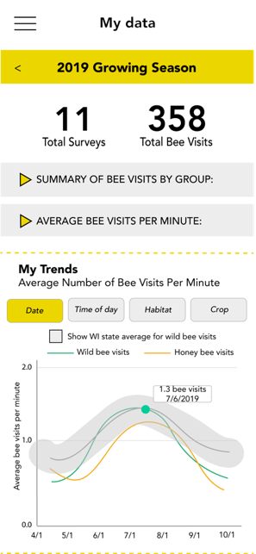
View your data in real time:
Notes:
Your data will help us to develop pollination models, so that we can eventually say with the app - yes you have a strong wild be community, or no your wild bee community is not providing full pollination. In the meantime, the data you collect is available to you to explore and observe any trends.

Slide 37
Why should I participate?
It’s fun – an opportunity to observe WI bee species
It’s easy and takes just 5 minutes to do a survey.
Your data is yours to explore - track the pollinators visiting your crops and local wildflowers over time.
Contribute to pollinator science and our understanding of Wisconsin’s wild bee communities!

Slide 38
WiBee: The Wisconsin Wild Bee App
www.pollinators.wisc.edu/wibee
Download the app
Learn to identify our 6 pollinator groups
Read the one-page guide to collecting data
Survey bees!
Sign up for our quarterly newsletter on our website
Submit W-9 form to receive $50 for participating
Notes:
As part of our inaugural year, we’re offering $50 to encourage you to help us collect data. Complete 3 surveys each day for a total of 3 days, and then send a W-9 form to pollinators@wisc.edu to receive a $50 honorarium.

Slide 39
Thank you!
Email us with your questions or feedback: pollinators@wisc.edu

