Slide 1
Variable Rate Irrigation for Vegetable Production
Yi Wang
Assistant Professor in Sustainable Vegetable Production
Department of Horticulture
University of Wisconsin – Madison

Slide 2
Background
Agricultural irrigation has been linked to reduced ground and surface water levels in the Central Sands region
New technologies and strategies that can improve the irrigation efficiency of vegetable cropping systems has become a top priority
About 99% of Wisconsin vegetable growers are using center pivot irrigation systems, and Variable Rate Irrigation (VRI) has been recently adopted by some pioneers
Benefits of VRI that have been observed include:
up to 25% of water saving on the farm
improvement of crop yield and quality at harvest
extended storage season

Slide 3
What is Variable Rate Irrigation (VRI)?
VRI applies water at variable rates rather than one uniform rate along the length of the center pivot
Varying the moving speed of the pivot or turning on and off individual nozzles
Electrical conductivity (EC) mapping or elevation mapping
Divide the field into management zones
VRI can apply water at differing rates to different crops or cultivars, varying soil types, high run-off areas or low areas prone to getting wet and saturated, and environmentally sensitive areas within the field

Slide 4
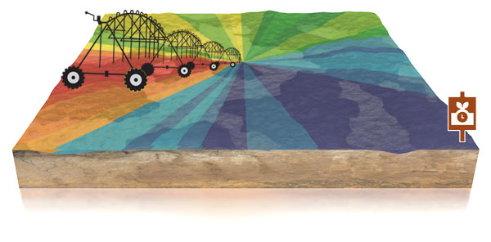
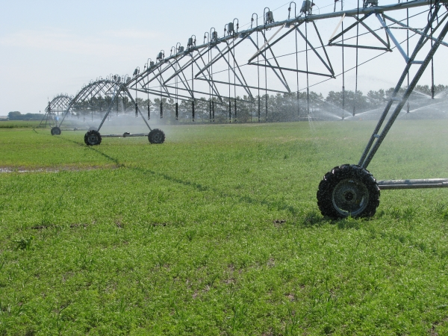
What is Variable Rate Irrigation (VRI)?
The overarching goal of VRI is to avoid over- and under-irrigation so no water is wasted and no water stress occurs, while crop yield and quality are maintained or increased
Currently the main hurdle of wide adoption of VRI is the upfront cost, ranging between $5,000 and $50,000 per pivot, and the potential of VRI to improve farm profitability

Slide 5
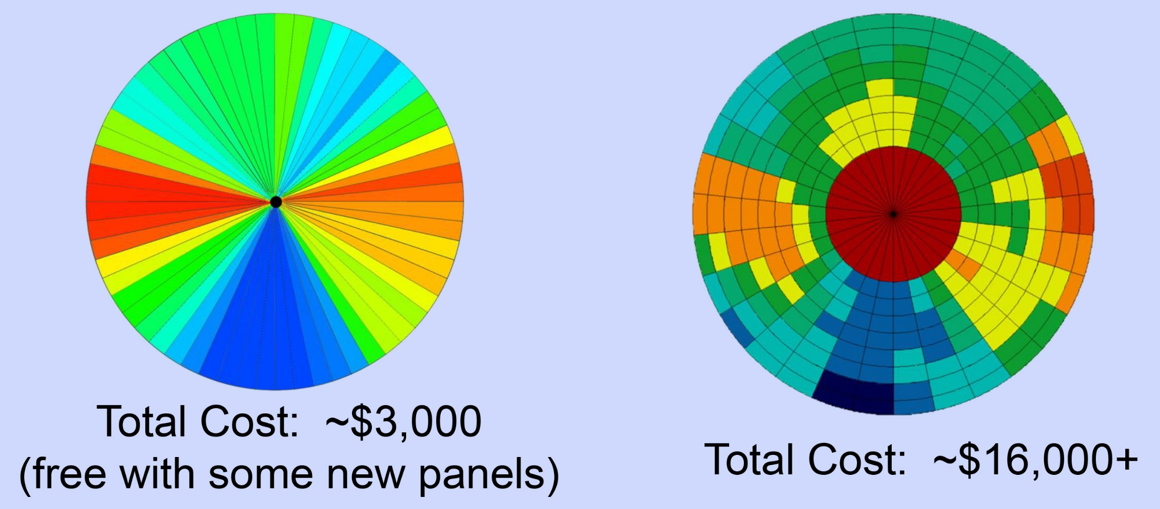
Speed control Nozzle control
Two types of VRI systems

Slide 6
Summer of 2018
Objective: evaluating on-farm vegetable production under VRI
Three commercial fields:
Potato field with nozzle control VRI
per event, irrigation to driest – to wettest = 0.3’’
Potato field with speed control VRI
per event, irrigation to driest – to wettest = 0.3’’
Snap bean field with nozzle control VRI but didn’t use it
every irrigation event was flat rate
Soil moisture sensors installed within and below rooting zone at the driest (highest) and wettest (lowest) spots on each field

Slide 7
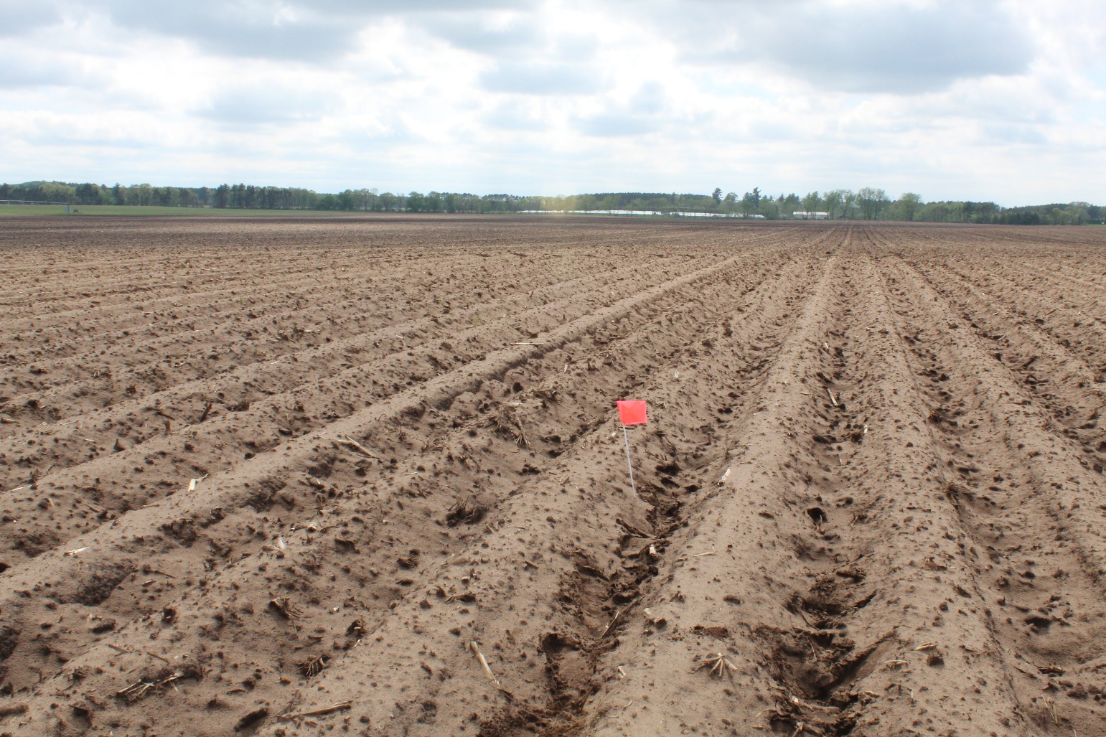
Farm 1 – potato
Wettest (lowest) spot right after precipitation
Driest (highest) spot right after precipitation

Slide 8
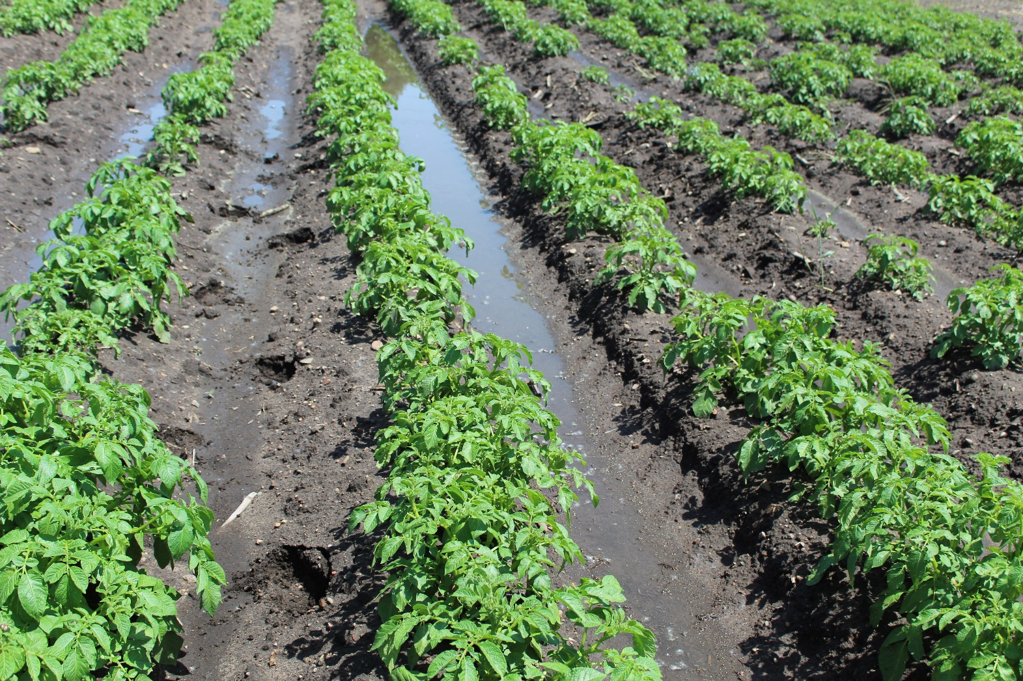
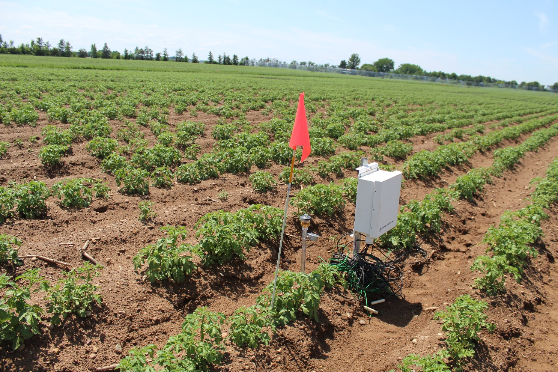
Farm 2 - potato
Wettest (lowest) spot right after irrigation
Driest (highest) spot right after irrigation

Slide 9
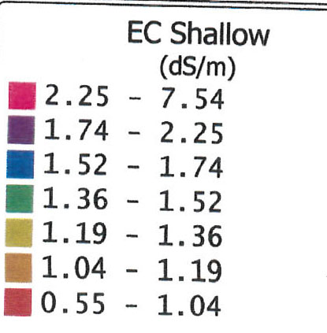

Slide 10
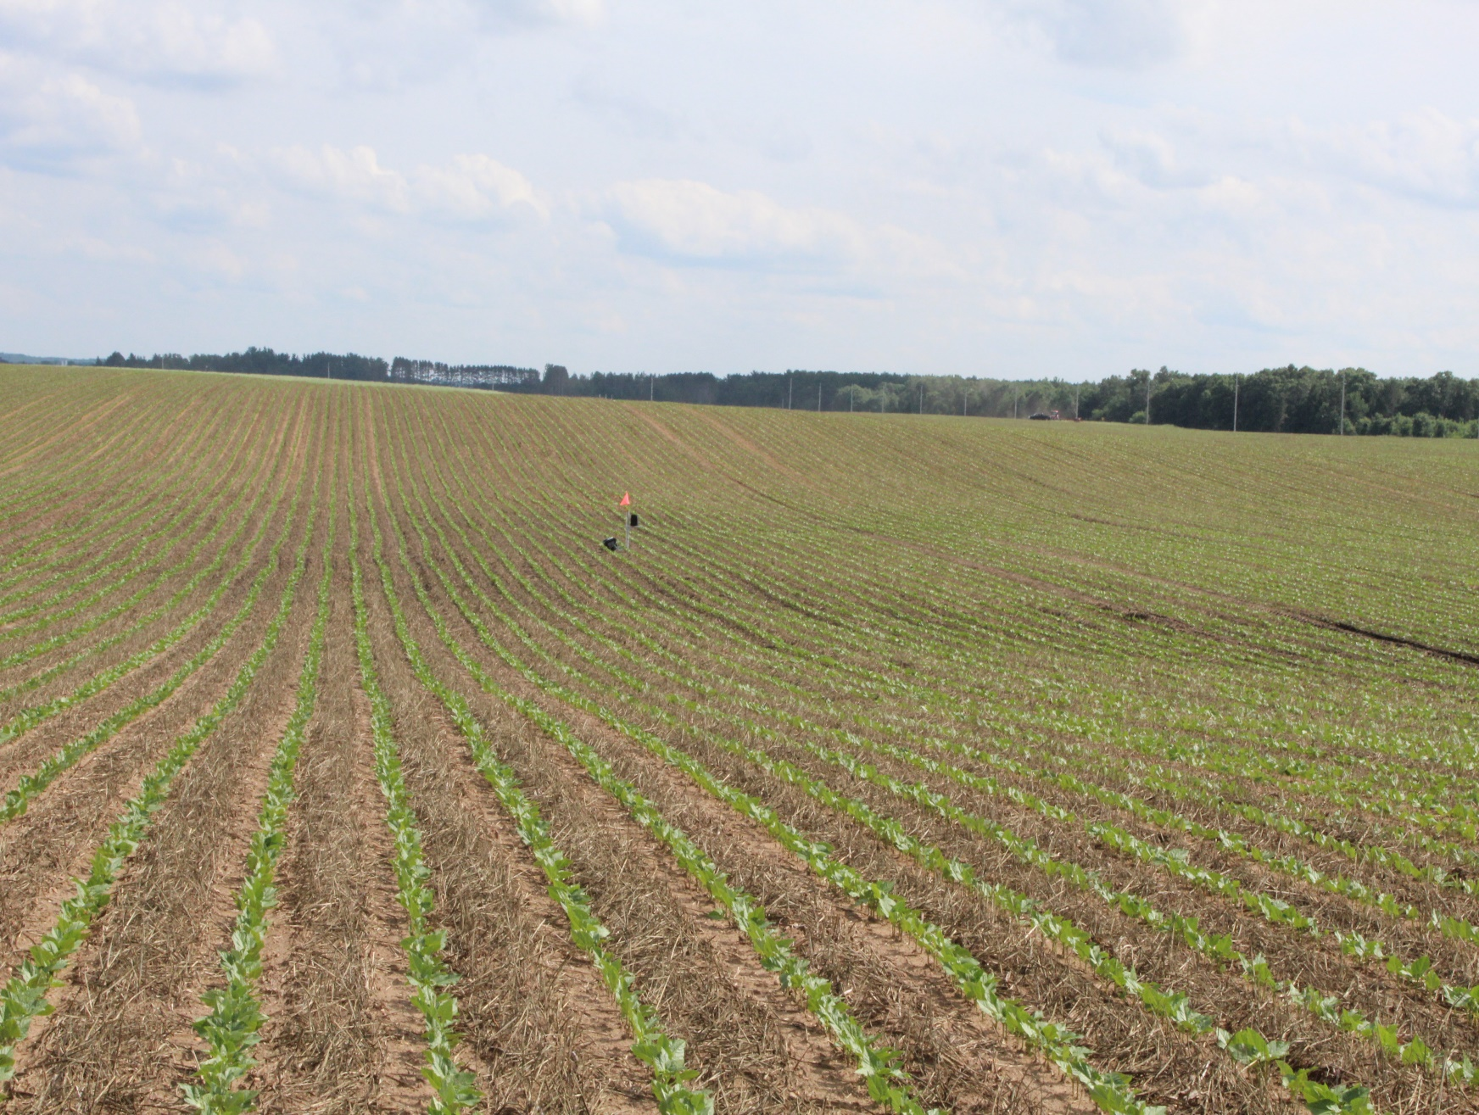
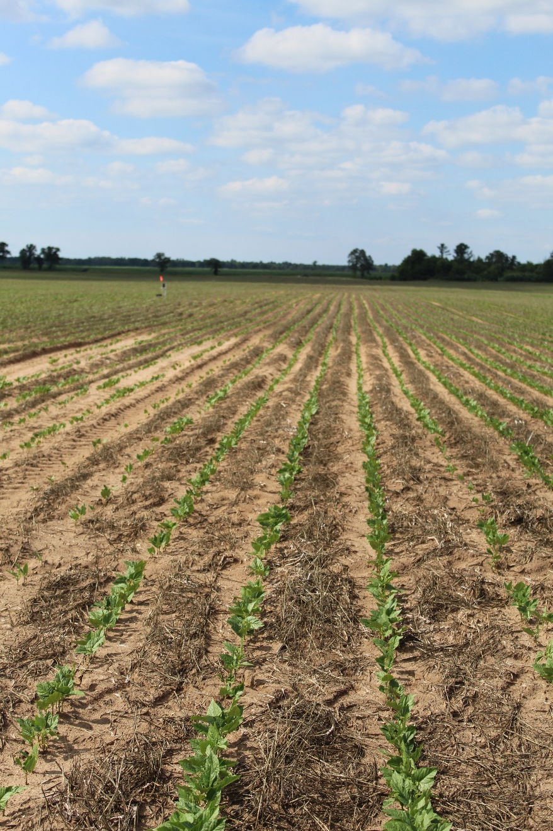
Farm 3 – snap bean
Wettest (lowest) spot
Driest (highest) spot

Slide 11
Farm 1 – potato – nozzle control VRI
2.5’’rain
0.8’’rain
1.7’’rain
0.3’’rain+0.4’’irri
1’’rain

Slide 12
Potato yield
A A B
a a a

Slide 13
Irrigation efficiency and water use efficiency of VRI on Farm 2
Total irrigation water applied to wet spot 10.6’’
Total irrigation water applied to average spot and dry spot 16.1’’
Total rainfall 23.4’’
About 0.15 million gallons of irrigation water per acre was saved
Spot | IE (cwt/inch irri. water)
WET | 0.123 | A
DRY | 0.093 | AB
AVG | 0.076 | B
Spot | WUE (cwt/inch irri. + rain water)
WET | 0.038 | A
DRY | 0.037 | A
AVG | 0.031 | A

Slide 14
Potato quality – specific gravity
Farm 1
Farm 2
Spot | SG
Dry | 1.077 A
Average | 1.081 A
Wet | 1.069 B
Spot | SG
Dry | 1.073 a
Average | 1.068 a
Wet | 1.068 a

Slide 15
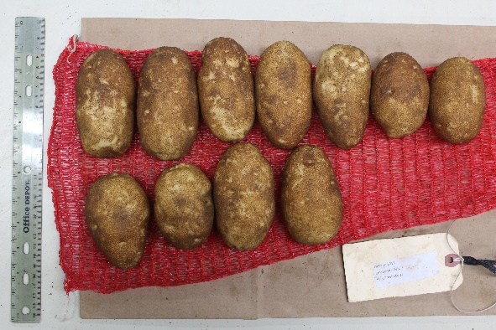
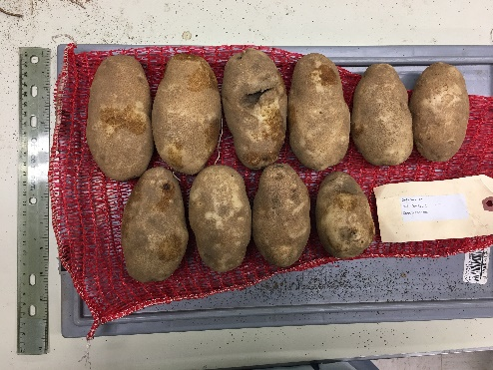
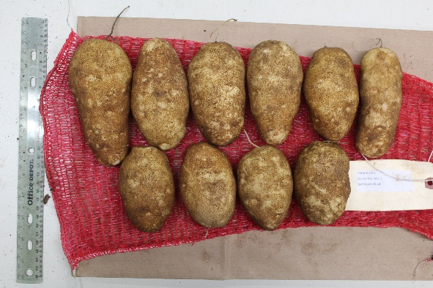
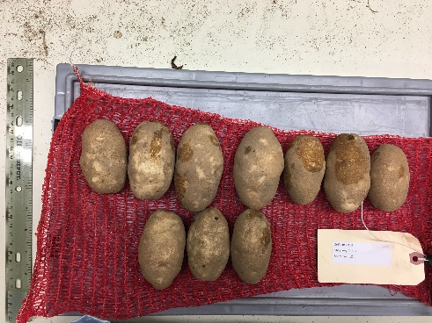
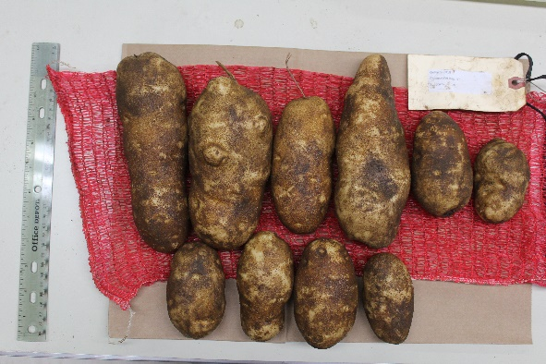
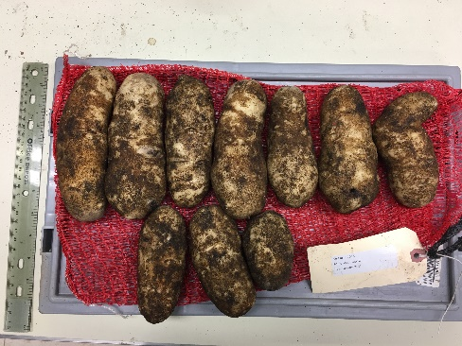
Potato quality – length to width ratio (tuber shape)
Farm 1
Farm 2
Spot | L/W
Dry | 2.14 AB
Average | 1.94 B
Wet | 2.26 A
Spot | L/W
Dry | 1.99 b
Average | 1.99 b
Wet | 2.34 a

Slide 16
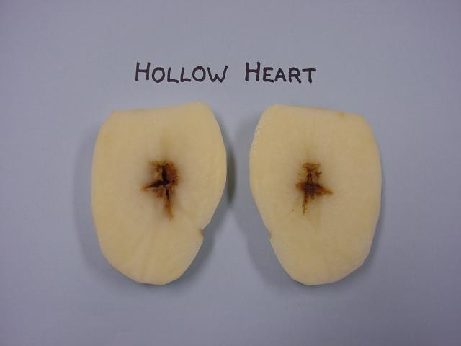
Potato quality – hollow heart
Farm 1
Farm 2
Spot | Hollow heart %
Dry | 8% A
Average | 13% A
Wet | 15% A
Spot | Hollow heart %
Dry | 3% b
Average | 5% ab
Wet | 13% a

Slide 17
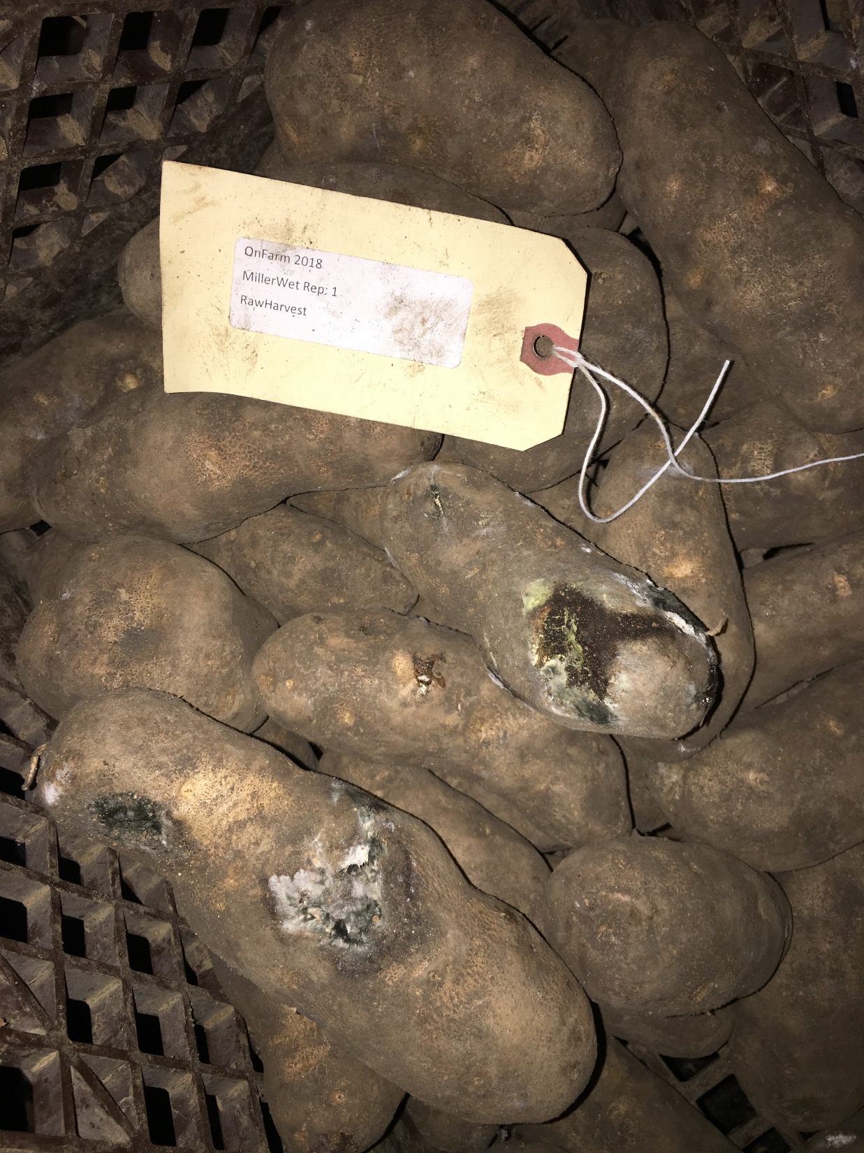
Rotting tubers from wet spot

Slide 18
Snap bean yield
B A A

Slide 19
Summary so far
The biggest benefit of VRI is at the driest (highest elevated) spot of the field
it can keep soil moisture within the crop rooting zone, and thus avoid yield penalty and quality reduction
VRI can save water pumping on the wettest (lowest elevated) spot of the field, and thus significantly improve irrigation efficiency
However the wettest spot of the field is still hard to manage, even with VRI, soils always saturated, tubers always have higher rate of rotting and defect issues
Future tweaking is needed

