Slide 1
New Technologies for future horticultural crop production
Yi Wang
Department of Horticulture
University of Wisconsin – Madison

Slide 2
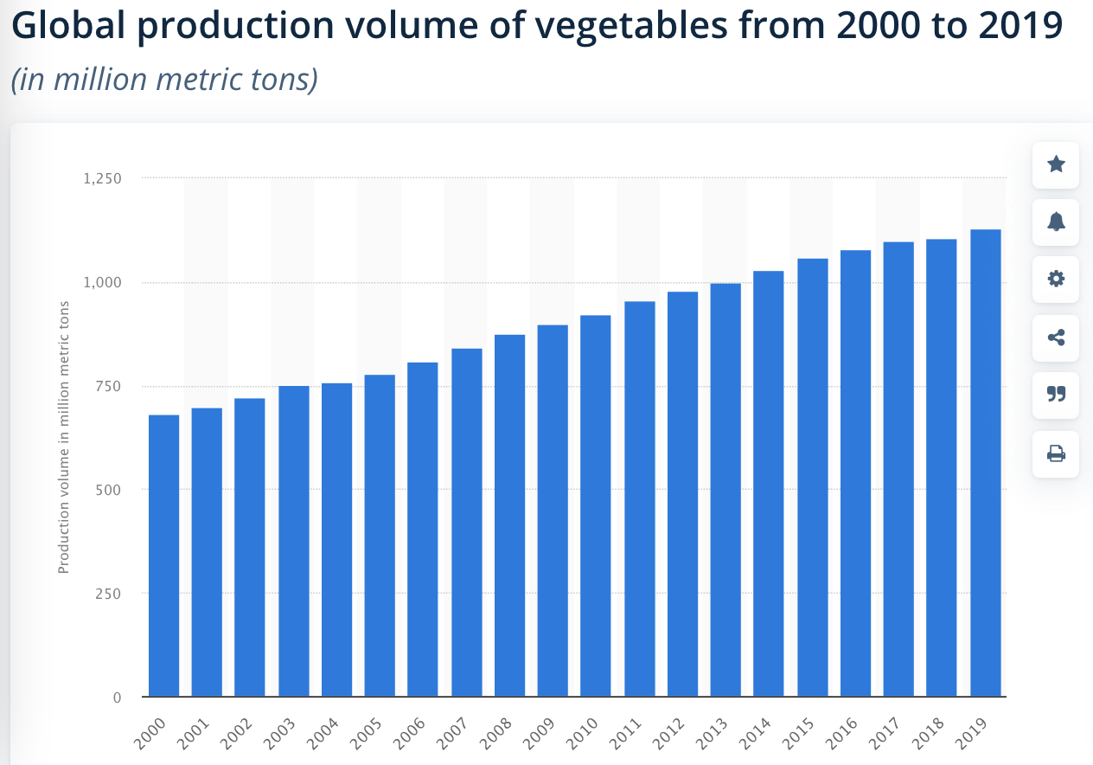

Slide 3
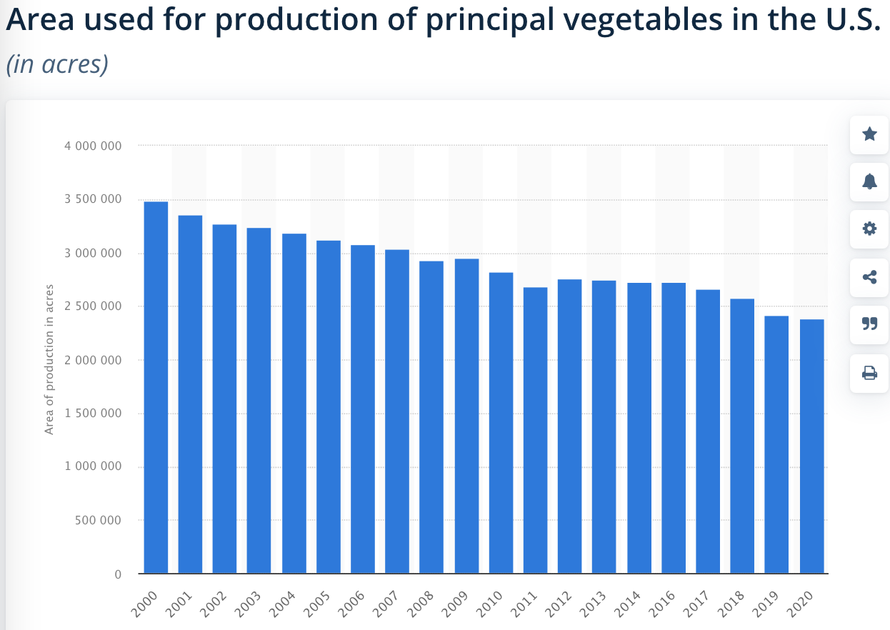

Slide 4
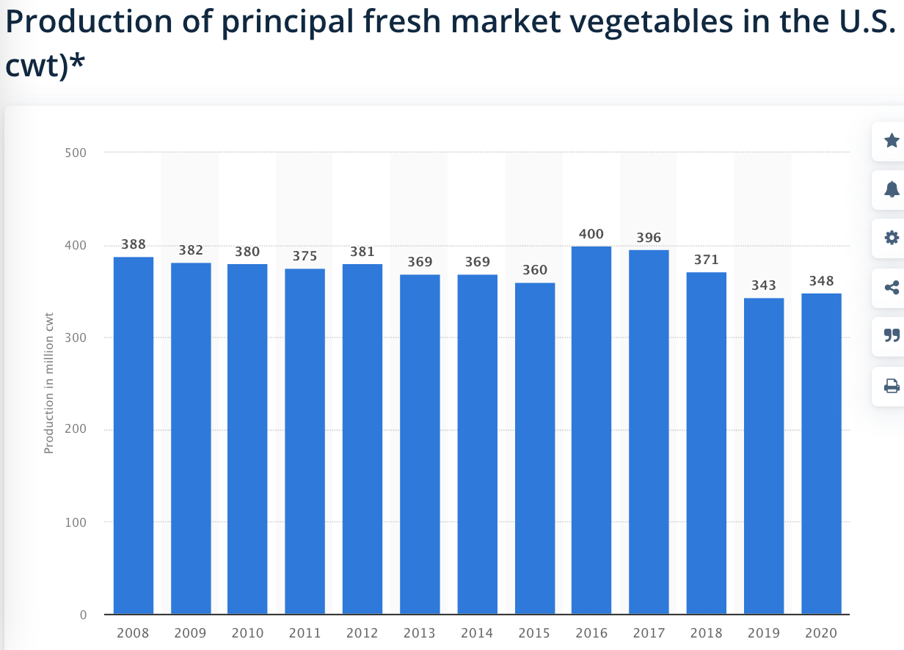

Slide 5
Grand challenges of vegetable production
Unpredictable weather conditions
Degraded environment
Shortage of labors and labor aging
More bigger farms, small farms disappearing

Slide 6
How can we achieve vegetable production sustainability?
By highly automated operation – horticultural mechanization
By precision agricultural practices that can increase resource use efficiency
Reduce impact of agricultural production on the environment

Slide 7
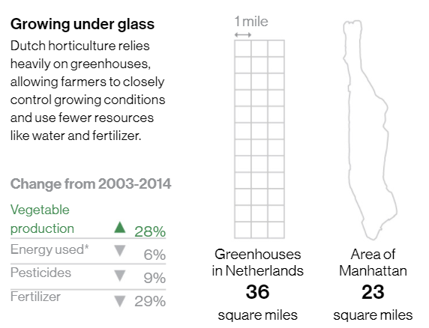
Horticultural Mechanization - Greenhouse Farming
The Netherlands is only about 34% the size of New York state
Greenhouse area in the Netherlands is a little bigger than Manhattan
But it is the second largest food exporter in the world
The mechanization of greenhouse production has greatly improved use efficiency of water, soil, chemical fertilizers and pesticides

Slide 8
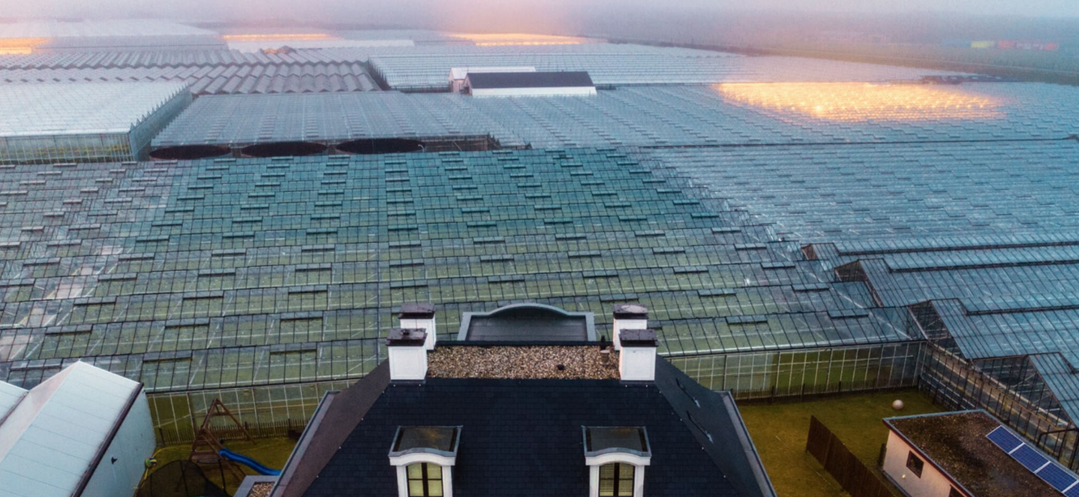

Slide 9
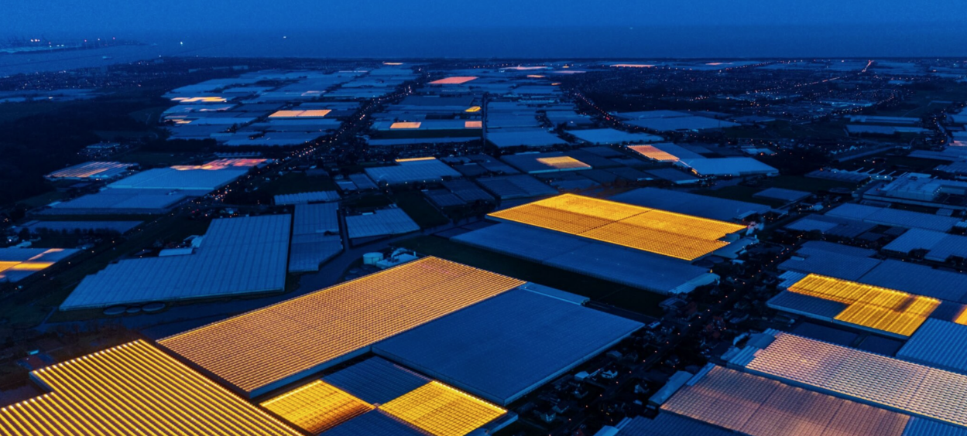

Slide 10
Greenhouse farming in the Netherlands
In 2019 alone, the Netherlands exported agricultural goods worth €94.5 billion, and this number increases every year
The Dutch agriculture is very efficient and it has become masters at increasing their food productivity per hectare, animal and/or labor unit, while reducing costs with new and innovative technologies
However, it should be said that the most profitable export sector within agricultural goods of the Netherlands is not food, but ornamental flowers and plants (worth €5.8 billion in 2019)
After that, it is not vegetables (€3.5 billion in 2019) that are the biggest agricultural export, but dairy products and eggs (€4.3 billion in 2019) and meat (€4.0 billion in 2019)

Slide 11
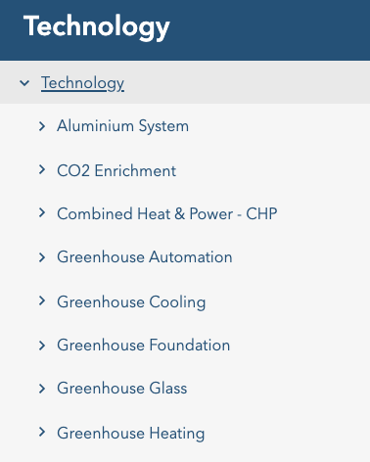
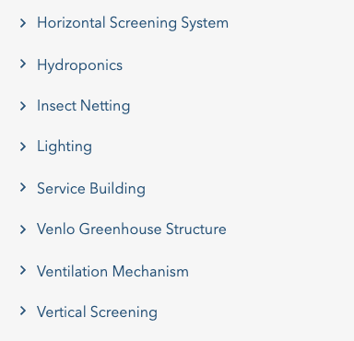
New technologies in greenhouse farming

Slide 12
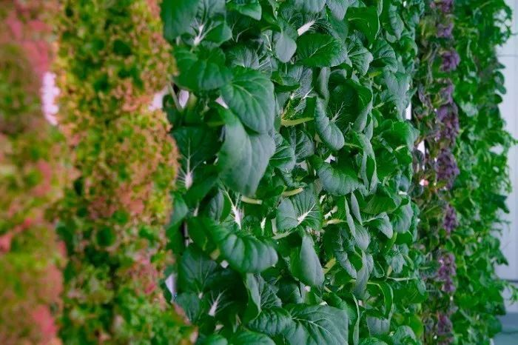
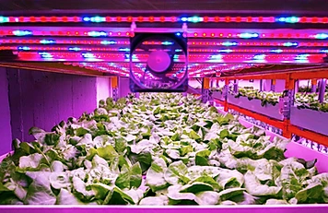
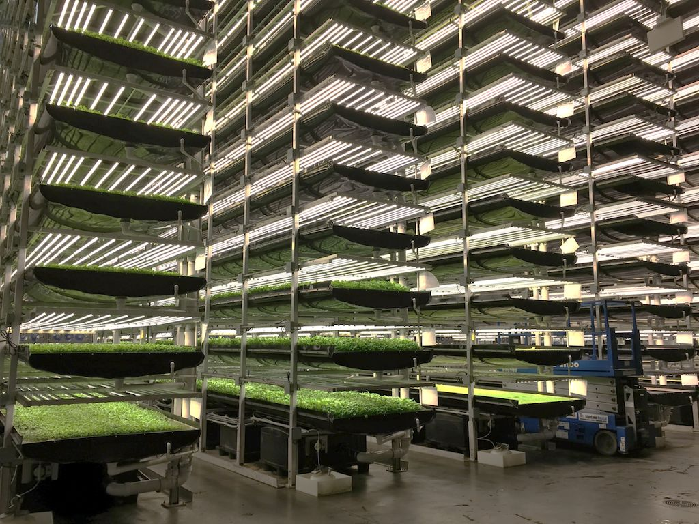
Horticultural Mechanization – Vertical Farming
An upgrade of greenhouse farming - grow the food people need right in the building
  LED lighting
  Natural light
All water is recycled and reused in the building
No pesticides are used on the plants, no pollution, no pests or diseases
The greenhouse gases produced are collected and turned into heat
The excrement of birds and fish can also be converted into energy
Vertical farms hope to feed the urban population of the 21st century

Slide 13
Vertical Farming Technologies
Vertical farms use smart sensors to monitor technical variables including temperature, CO₂, O₂, lighting, humidity, nutrient concentration, pH, pest control, irrigation, and harvesting
Moreover, vertical farms can utilize advanced imaging and sensor technologies including cameras and thermal imaging to measure plant growth, temperature, and other factors
Presently, vertical farms have proven highly effective in growing leafy greens, herbs, microgreens, and vegetables such as tomatoes, peppers, melons, and sweet corn.

Slide 14
Micro-irrigation
Drip, or micro-irrigation, technology uses a network of plastic pipes to carry a low flow of water under low pressure to plants. Water is applied much more slowly than with sprinkler irrigation
Drip irrigation exceeds 90 percent efficiency whereas sprinkler systems are 50 to 70 percent efficient
Low volume application of water to plant roots maintains a desirable balance of air and water in the soil
Slopes are inefficient to irrigate because gravity pulls water downhill, causing runoff and water waste. The slow rate of water applied through drip irrigation is more likely to soak in before it runs off

Slide 15
Disadvantages of micro-irrigation
If emitters are poorly placed, too far apart or too few in number, root development may be restricted by the limited soil area wetted
Water seeping at ground level is hard to see and makes it difficult to know if the system is working properly
An indicator device that raises and lowers a flag to show when water is flowing is available to overcome this issue
Regular maintenance inspections are needed to maintain system effectiveness – the same as with high pressure sprinkler systems
Clogs are much less likely with filtered water and proper pressure regulation used in combination with self-cleaning emitters
Drip tubing can be a trip hazard especially for dogs and children but is less problematic if covered with mulch and fastened with wire anchor pins every 2 to 3 feet

Slide 16
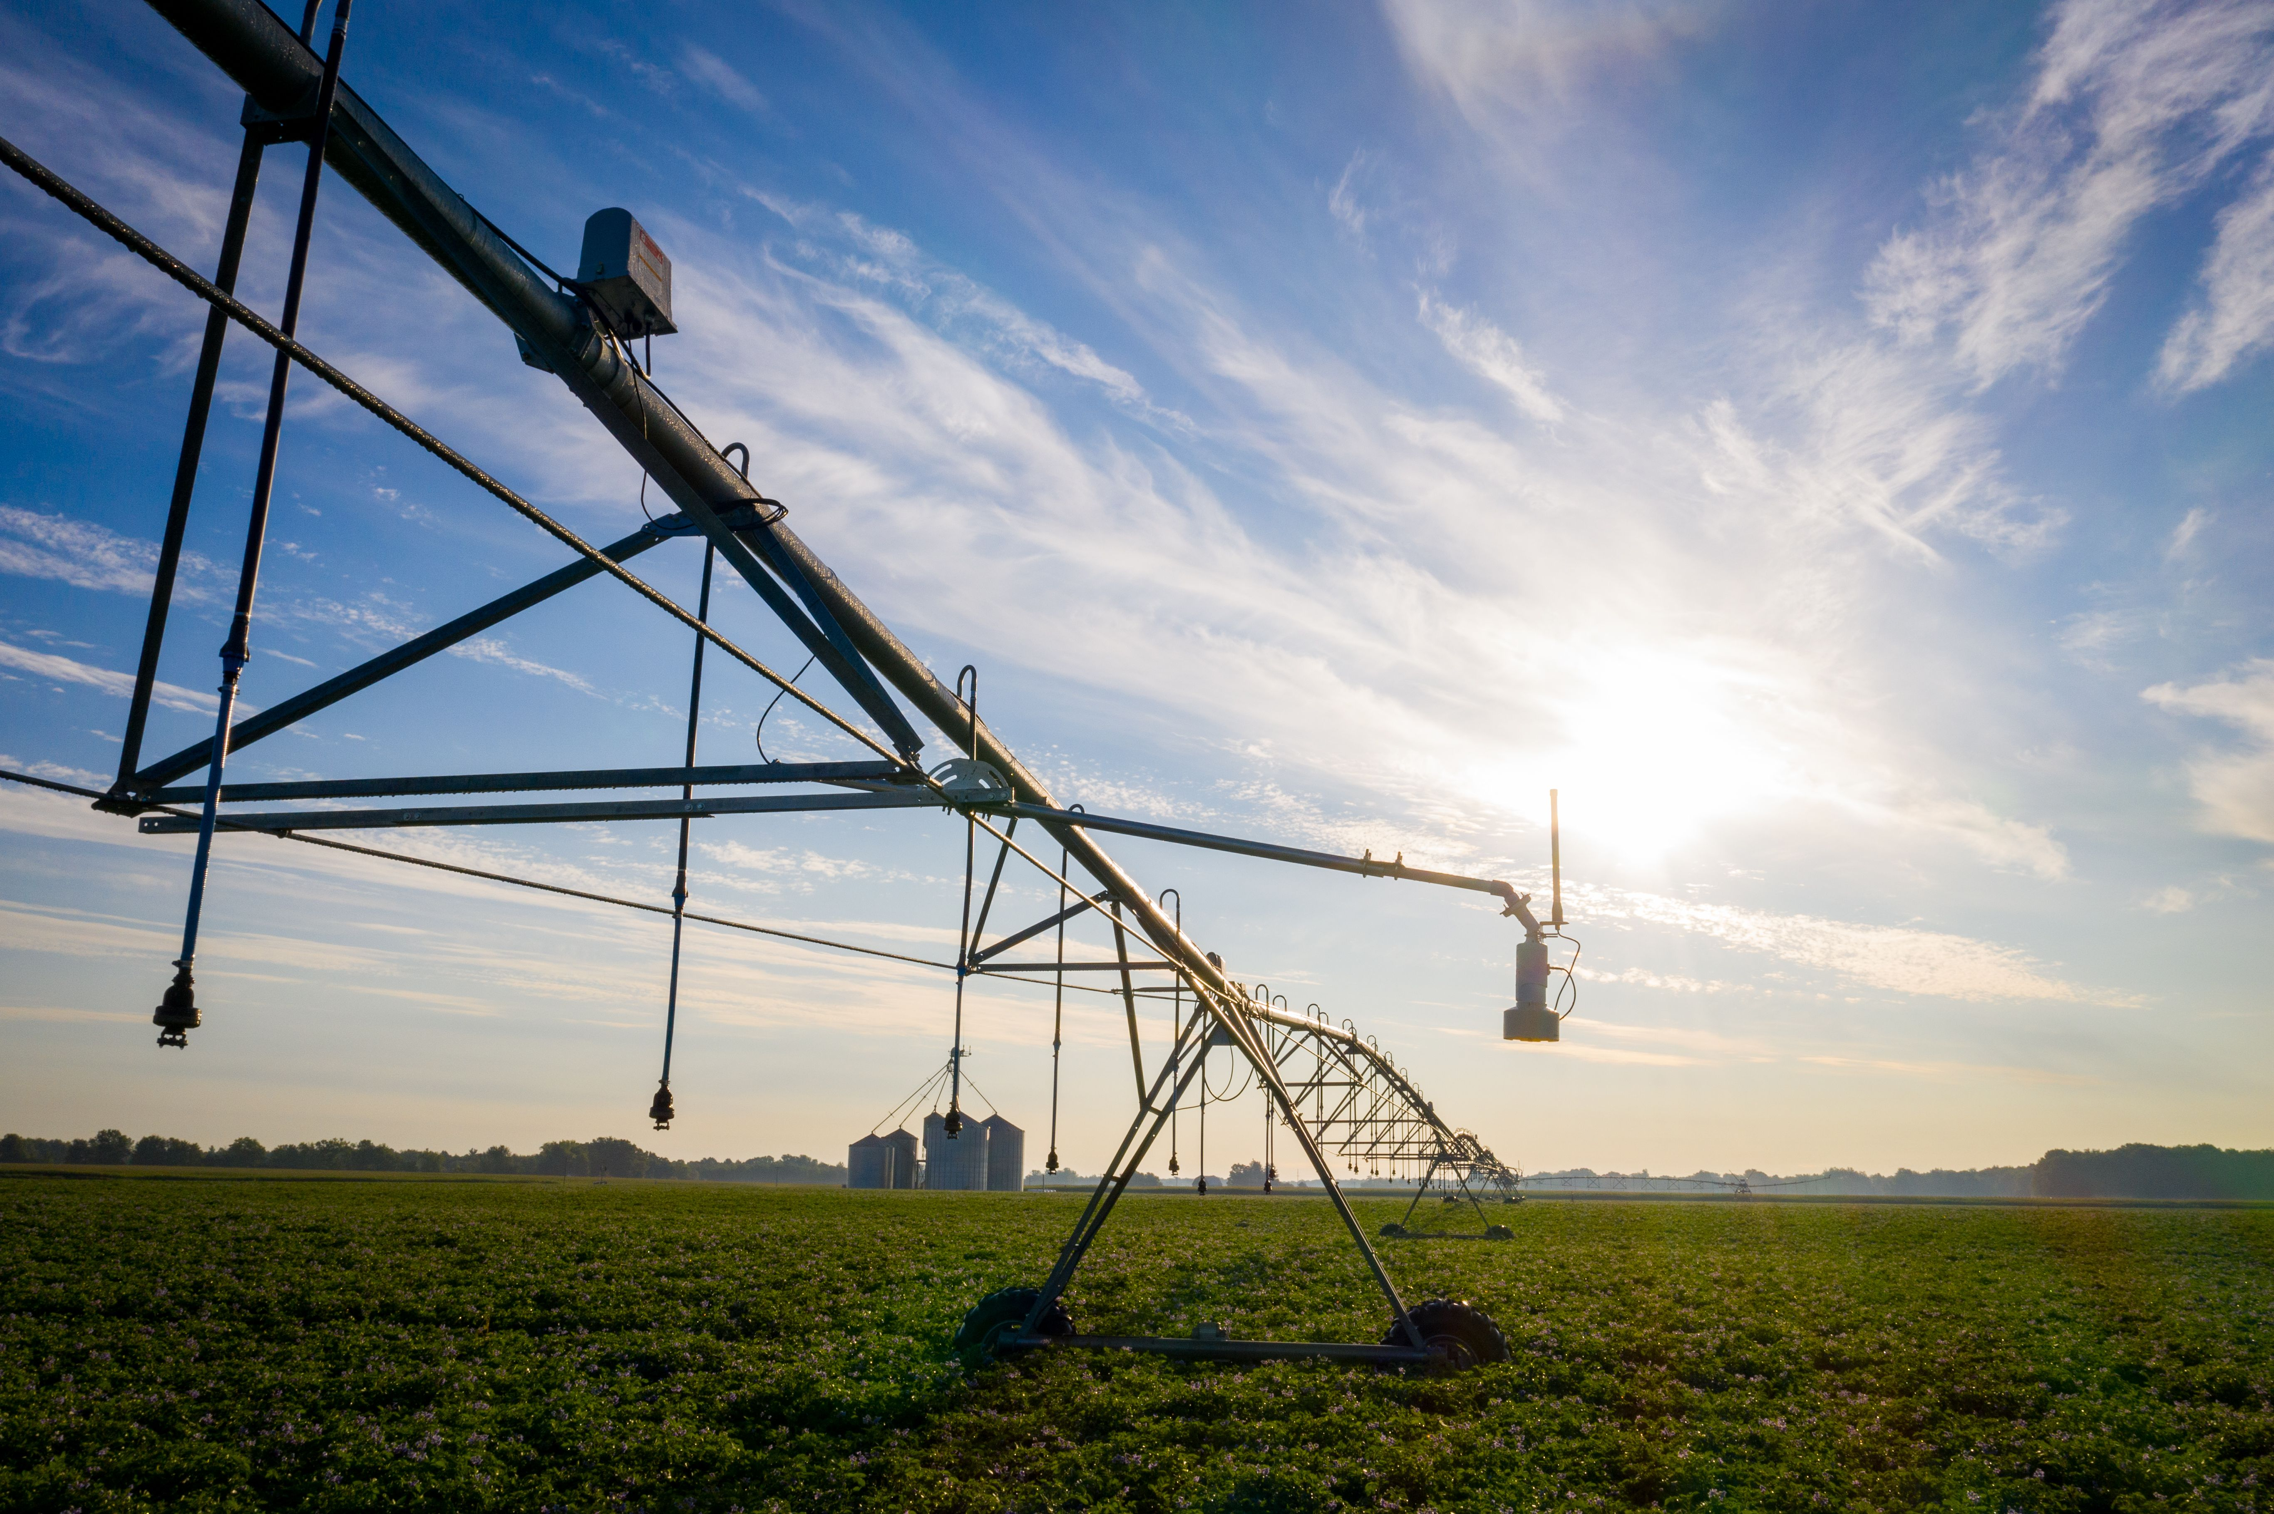
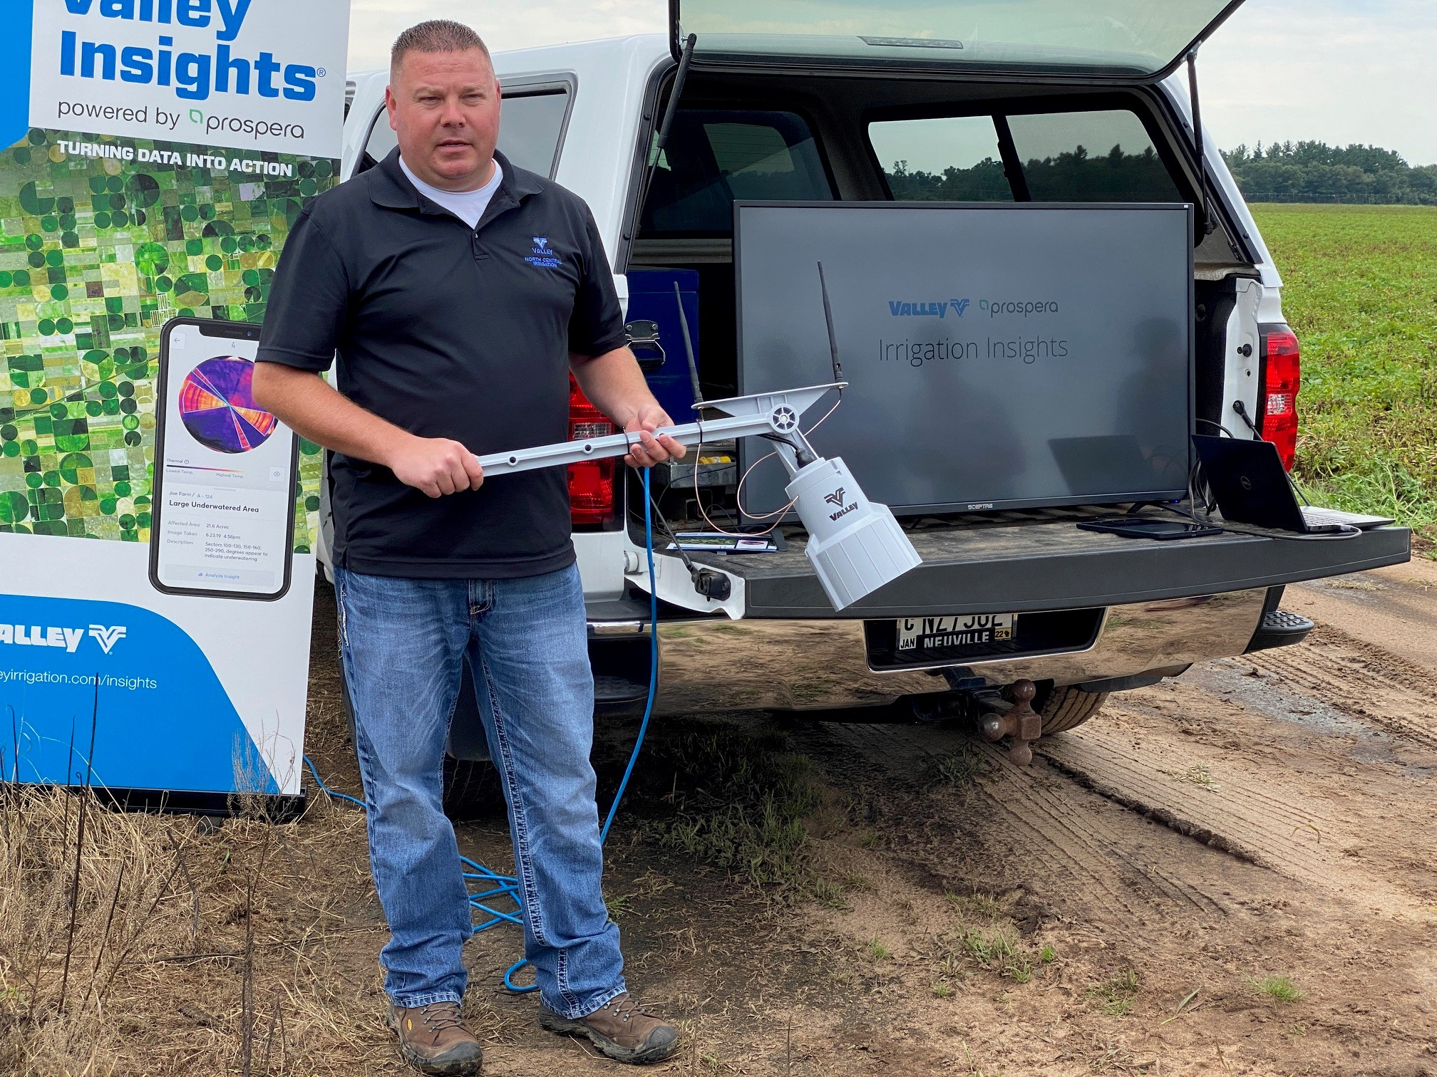
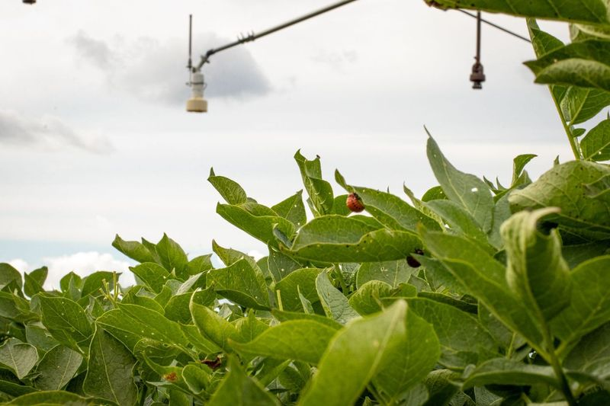
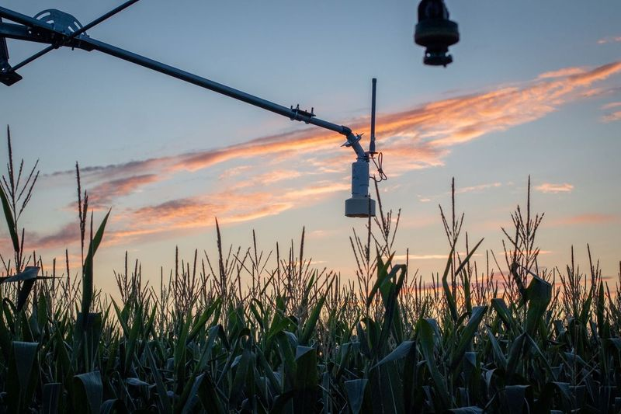

Precision agriculture – remote sensing and use of on-pivot sensors
Notes:
Throughout the 2019 and 2020 season, we’ve implemented sensor kits which have been collecting and analyzing data, which allows us to advance imagery collection and identification of field issues.
As the machine passes through the field (water on/off), the sensors capture images from each sensor.
To fully provide a higher level of machine learning, we gain validity by continual image capture. The sensors capture the same portion of the field with the outer spans imagery taken every 20-40 seconds and the inner span imagery every few minutes. This further validates findings as the data is fed back through the intelligence model to detect the specific anomaly related to the plant.
Currently we’ve tested on acres specific to high value crops like potatoes and increasing our image capture in the areas of corn, cotton and sugarbeets.
With over 100,000 connected machines, we have a greater collection of data for machine learning (ML) increasing our level of accuracy and ground truth

Slide 17
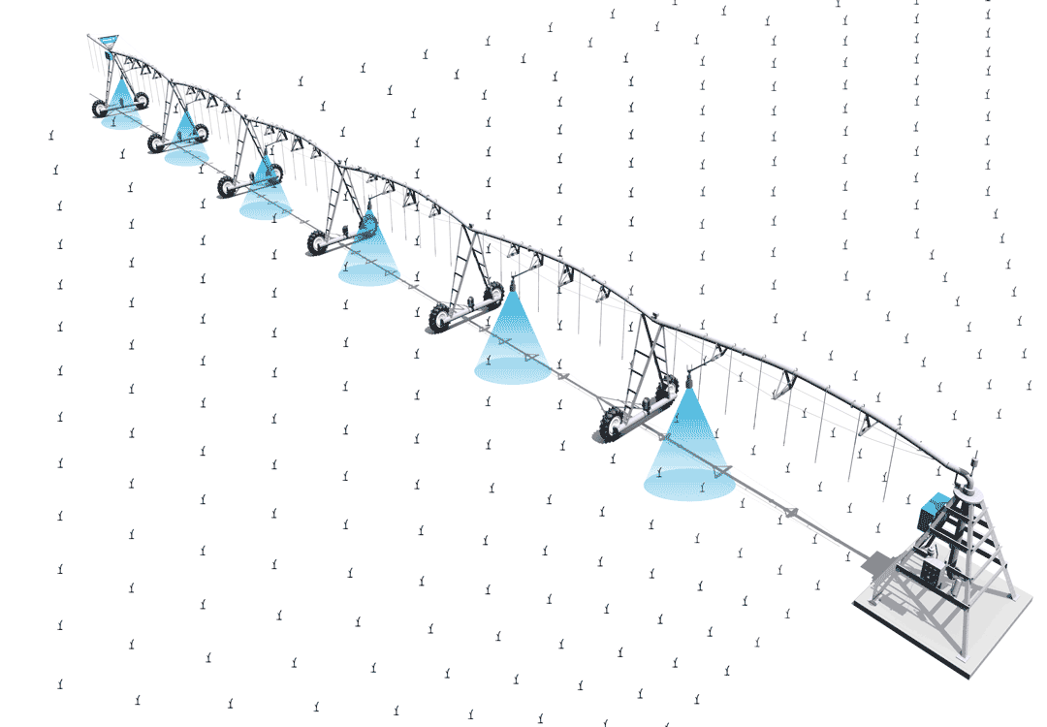
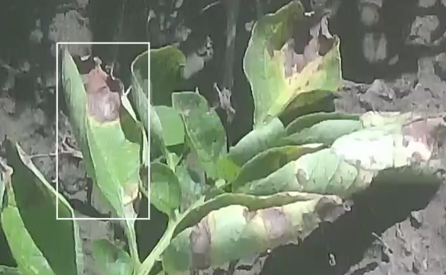
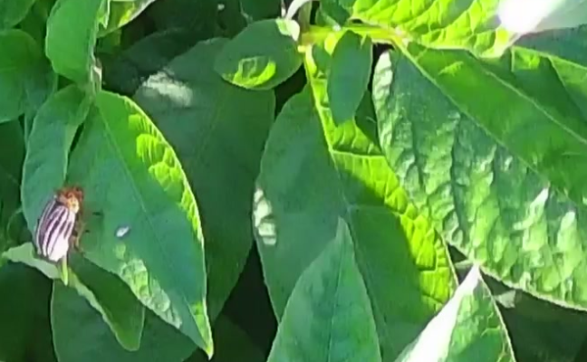
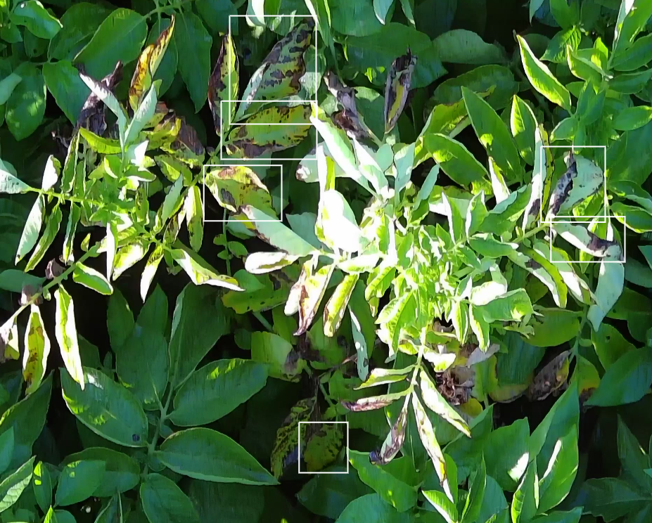
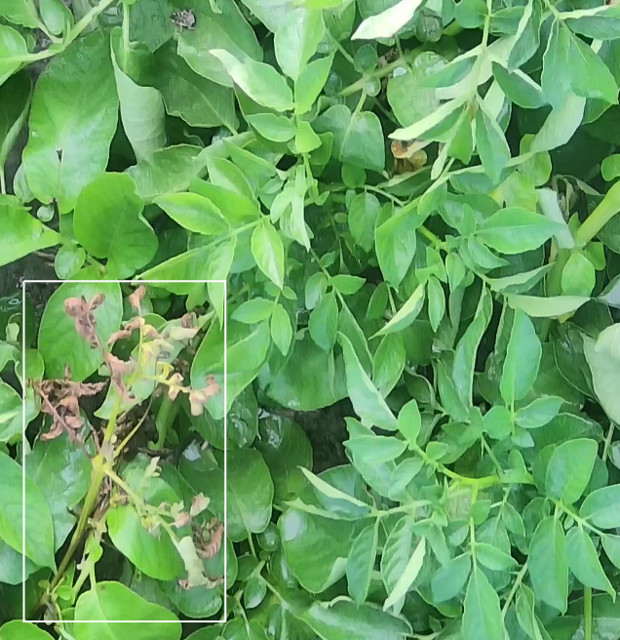
On-Pivot Sensors Detection
It can collect thousands of images every time the center pivot passes the field
Notes:
The mounted on-pivot sensors collect thousands of high-resolution images as the pivot moves through the field.
Images are then analyzed by Prospera’s Computer Vision (AI) technology, producing reports and insights that can impact yield all while aiding additional machine learning (ML) capabilities for continuous improvement.

Slide 18
Collect
Scout
On-Pivot Sensor
Weekly Visits
In-field Coverage 24/7 More acres covered across
entire field
Notes:
The coverage and frequency of collection is important.
For many large growers, their agronomist will continue to scout and drones may capture a certain amount of coverage as needed but also may be hindered by weather related concerns.
As you can see, the pivot provides the greatest amount of coverage in your field and is equipped and ready to go at any point.

Slide 19

Detect
DETECTION
EMERGENCE
STAND
COUNT
WEED
INSECT
DISEASE
NUTRIENT DEFICIENCY
Notes:
We understand areas of high-dollar crops and large growers face particular challenges in scalability while being privy to cutting-edge of technologies that will increase their profitability.
Because of this, we've concentrated our preliminary limited release areas of detection, at this time, to specific regions and crops.
Greater profitability can be achieved through reduced inputs. Accuracy and validation from the experts gives growers new eyes in the field with greater frequency to detect pest, disease and overall plant health.

Slide 20
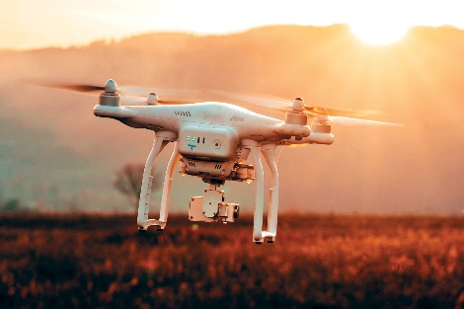
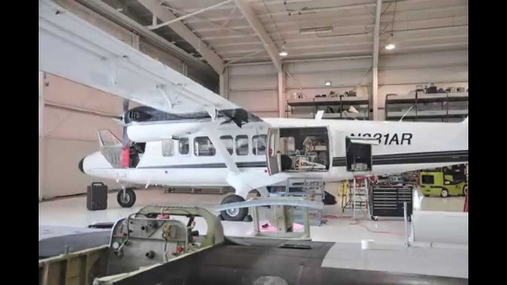
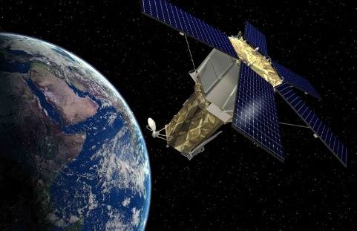
Precision agriculture – remote sensing
UAV, Aircraft, Satellite
 | UAV | Aircraft | Satellite
Ground Resolution | high | high | Low
Ground image dimensions | Small | Medium | Large
Spectral cameras | Multi- or hyper- | Hyper- | Multi-
Operation personnel | One or two people | One or two pilots and at least one operating person | No personnel needed
Interval | Anytime | Anytime | Typically every three to five days

Slide 21
Predicting in-season plant N status:
Liu et al. 2021
Remote Sensing of Environment

Slide 22
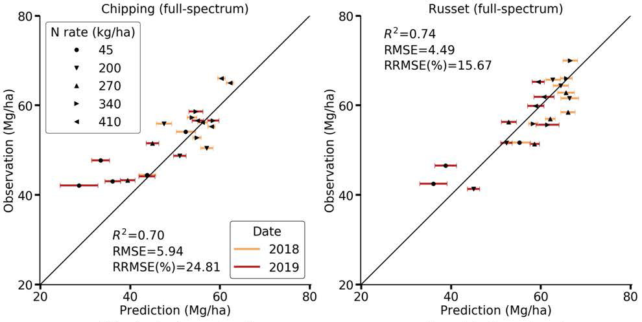
Yield data validation for chippers and russets
Liu et al. 2021
Remote Sensing of Environment

Slide 23
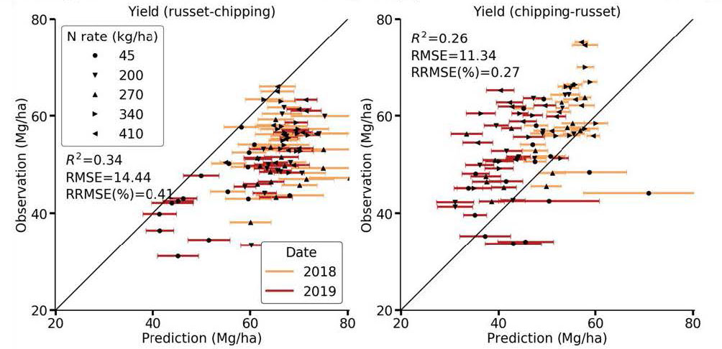
Cross validation of chippers and russets
Liu et al. 2021
Remote Sensing of Environment

Slide 24
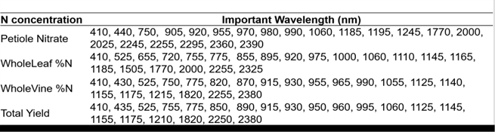
Top 20 spectral bands to predict potato N status and yield
Those bands are mostly within the 400-1300nm range, which are the visible and near-infrared wavelength regions

Slide 25
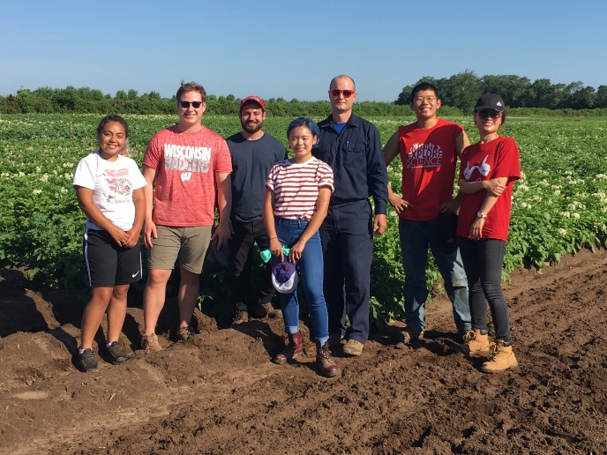
Acknowledgements:
Trevor Crsoby, Guolong Liang, Alfadhl Alkhaled, Taqdeer Gill, Ophelia Tsai, Mack Naber
USDA-NIFA-AFRI
USDA-NRCS
WPVGA
Wisconsin Fertilizer Research Council
WI DATCP
UW-Madison CALS
email:
wang52@wisc.edu
webpage：
https://uwveggies.wiscweb.wisc.edu/
Twitter：
@appealingmm

