Slide 1
Current financial trends
Paul Dietmann, Senior Lending Officer – Mission Financing
Compeer Financial
WI Fresh Fruit and Vegetable Conference, Agritourism Track
January 26, 2020
Wisconsin Dells

Slide 2
Compeer Financial
Formed in 2017 by merger of three Farm Credit System cooperatives: Badgerland Financial; AgStar; 1st Farm Credit
Rural lending (& other financial services) cooperative
Any owner of agricultural assets or person engaged in ag production is an eligible borrower
Largest ag lender in Upper Midwest…$20 billion in assets
Approximately 45,000 members
Recently paid $150 million in dividends back to members based on 2018 profits

Slide 3
How I ended up in Wisconsin

Slide 4
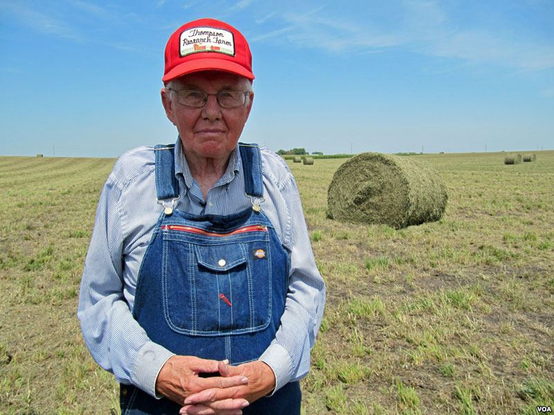
A few statistics
Average age of a US farmer is 59, and 70% are over age 55
Thirty percent of beginning farmers were 35 or under, but 10% were over 65
2/3 of beginning farmers had income under $10,000/year
Data source: USDA Economic Research Service

Slide 5
Farm income declining
Income peaked in 2012, now running near long-run, inflation-adjusted averages
From 2012 to 2017, largest % drop in net income since 1970s
40% of net farm income in 2019 projected to come from government subsidies and crop insurance
Sources: USDA-ERS and American Farm Bureau Federation

Slide 7
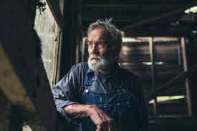
Farm debt rising, repayment stretching longer
Total farm sector debt is approaching levels of late 70s/early 80s
Farmland values have stalled out, debt-to-asset ratios rising
Low interest rates have muted the impacts to some extent
85-90% of farms are not considered to be under financial stress
Most likely to be stressed: larger farms
Source: USDA-ERS

Slide 8
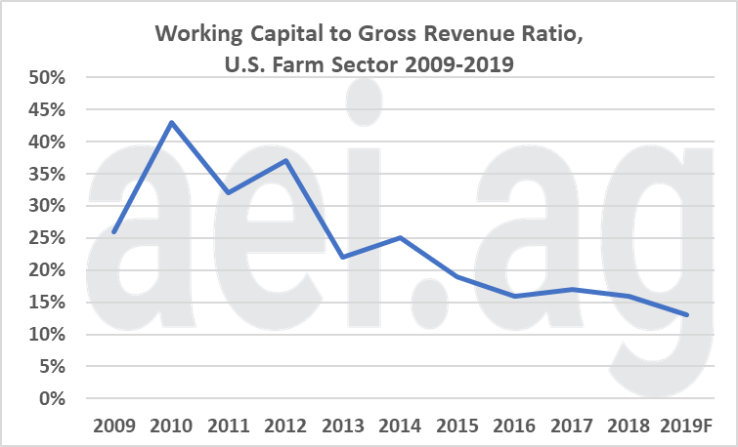
Debt And Working Capital
Source: USDA-ERS data via agricultural economic insights (aei)

Slide 9
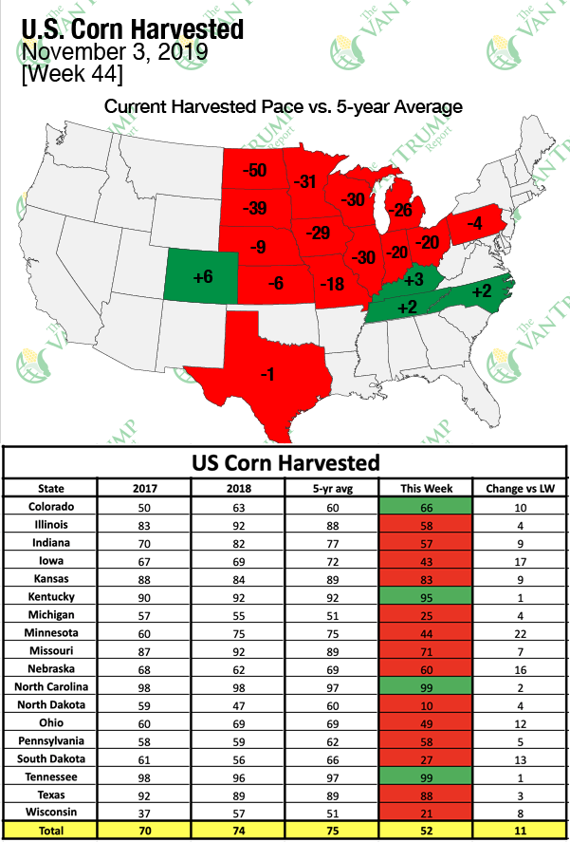
2019…
Trade wars with major export markets
Glut of milk in conventional and organic markets
Fuel, fertilizer, seed costs down
Terrible weather conditions in spring and fall
Farmers are very discouraged
Source: The Van Trump Report 11-5-19

Slide 10
2019 in lending…
Some large banks reducing their ag portfolios
Many lenders reducing loan:value ratios and discounting collateral
Short-term debt rolling into longer term debt
USDA-FSA funding has been pretty good
Some farms in serious financial trouble but majority are still okay

Slide 11
When access to commercial credit starts to dry up…

Slide 13
Well, that was quite a bummer. What’s next?

Slide 14
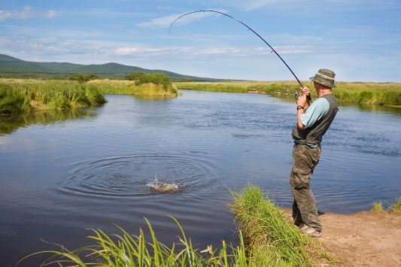
Short run – next one to two years
Net farm income likely to decline further; highly dependent on weather and politics
Even with relatively low rates, total interest expense will be a bigger burden
Land values are holding so far, but could drop if stressed farms are forced to sell
If farm economy is pushing farmers out, non-farm economy is pulling them too

Slide 15
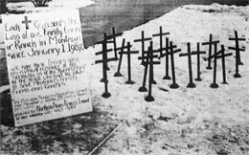
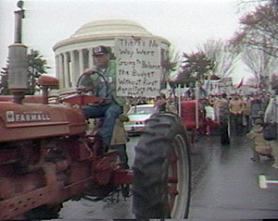
This isn’t the 1980s

Slide 16
Why I’m optimistic about the future
Tough times spark creativity and innovation
Founded in 1988 as Coulee Region Organic Produce Pool (CROPP).

Slide 17
Why I’m optimistic about the future
Many farms still have positive cash flow even if they are unprofitable
Farmers are very interested in “regenerative ag” practices
Adoption rate of cover cropping
Interest in improving soil health
Organic grain production
Perennial agriculture
Farmers have been minimizing capital purchases and cutting operating expenses

Slide 18
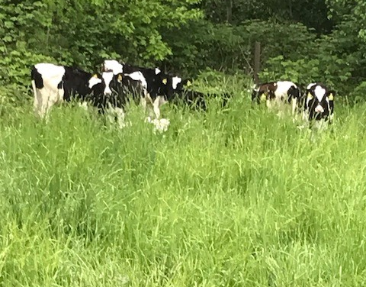
Why I’m optimistic about the future
Consumers are increasingly concerned about food production methods and are willing to pay more for food that fits their values
A new generation of farmers who understand the consumer above
Millions of acres will change hands in the next twenty years

Slide 19
I’m particularly optimistic about agritourism
Non-farm economy is relatively strong
Changing work culture: more flexible and family-oriented
Consumers choosing more experiences over more stuff, and authenticity is really important
Green travel, food-centered travel, mindful travel

Slide 20
Some unknowns

Slide 21
Your thoughts?

