Slide 1
What’s New in Apple Varieties
What’s in ,What’s out?
Presented by: Steve Louis, Oakwood Fruit Farm

Slide 2
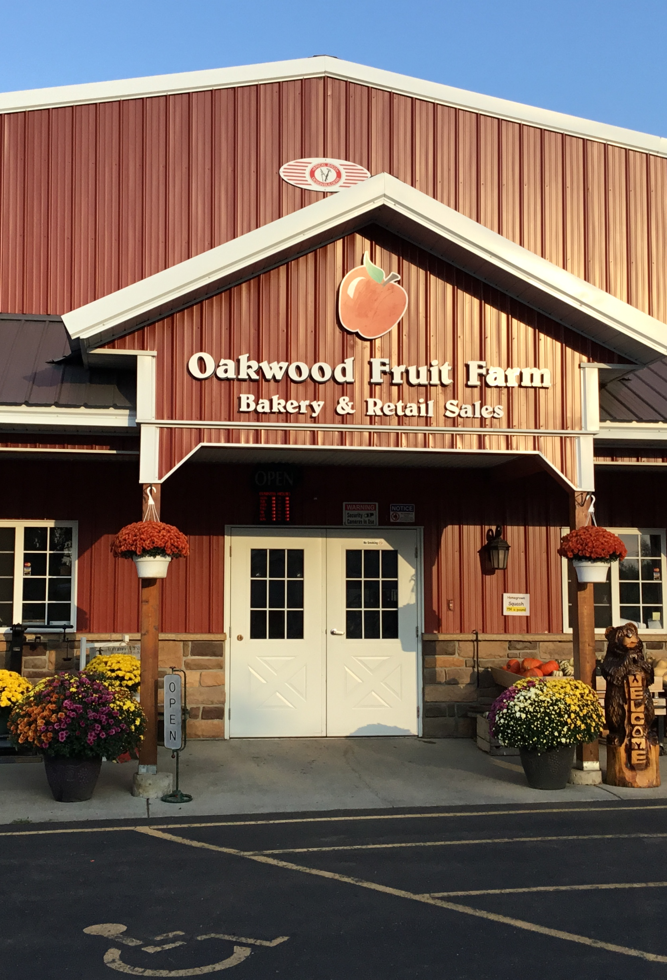
Who Am I:
Steve Louis
President Of Oakwood Fruit Farm
Graduated from UW Madison with a degree in Horticulture
180 acre apple orchard near Richland Center, WI
4th generation family business, 117 years in operation
We have a wholesale operation and a retail store

Slide 3
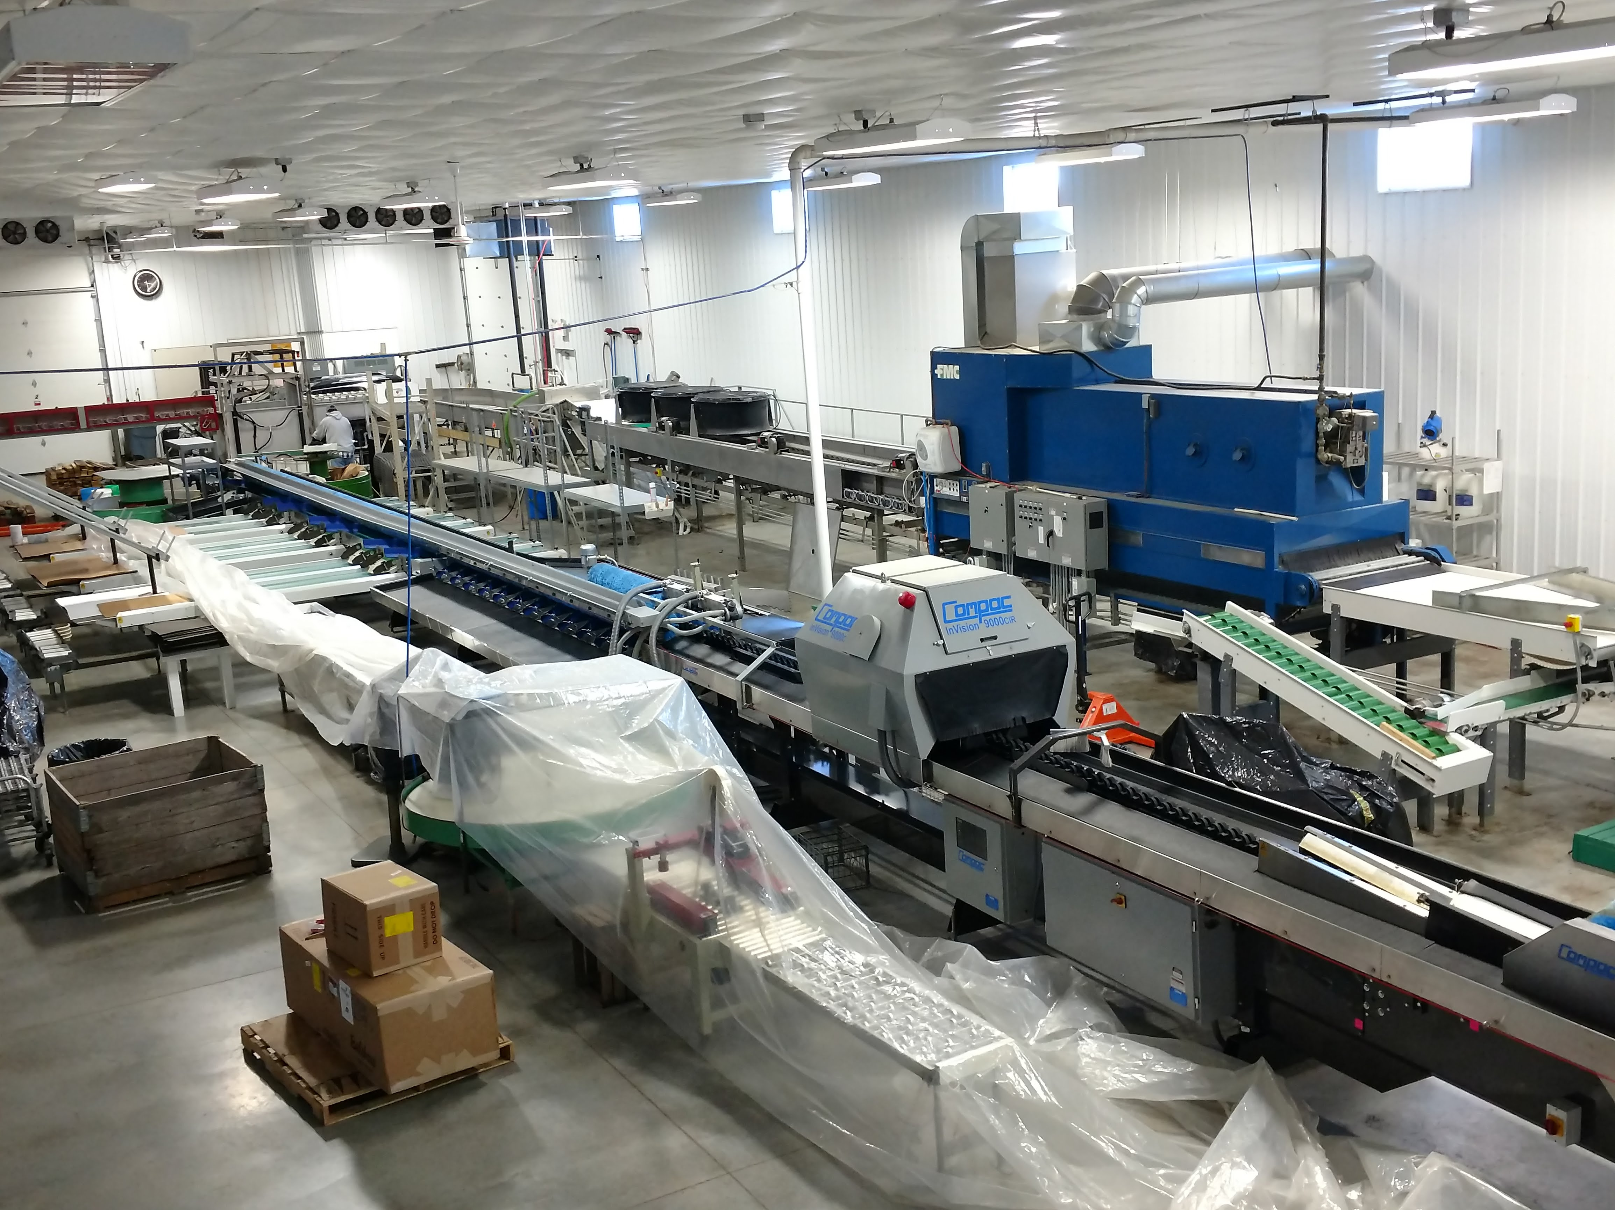
Wholesale Side:
Pack our own apples
Market with Wescott Agri products out of Elgin, MN

Slide 4
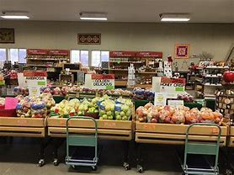
Retail Side:
Farm market and bakery
Open mid August to late December

Slide 5
We have both and have to think both ways
Wholesale vs Direct Market
Know your market when making planting decisions
What you plant depends on how and when you market

Slide 6
Wholesale Side
Pick and ship or long-term storage
What are your buyers wanting and in what amounts
Is there a “Gap “ in your season and can you fill it? Picking schedule or marketing?

Slide 7
Wholesale side
The Grocery store shelves have become very crowded, must buyers now sticking with old favorites
Gala, Fuji, Honeycrisp, Granny Smith, Pink Lady
Old standbys that are losing ground:
McIntosh, Cortland, Jonagold ,Red and Golden Delicious
Consumers are baking less
Less families, single people buy less fruit

Slide 8
Wholesale side
Randy Riley, the Director of Produce for Kroger foods, one of the largest grocery chains in the US said,
“Too much internal competion from less then ideal varieties with declining sales is a burden on the whole apple category, because they are taking up valuable shelf space. Apple growers should learn from other industries like automakers. It was only a short time ago when they nearly went bankrupt because they were holding on to outdated models. When the they had declining sales in brands that had perceived quality issues, what did they do? They cut the dead wood out.”
He delivered this message as the keynote speech at the annual U.S. Apple Association outlook conference.

Slide 9
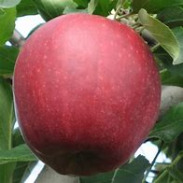
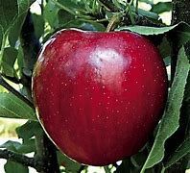
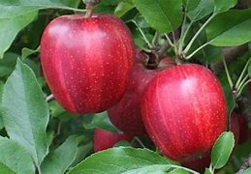
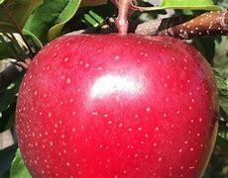
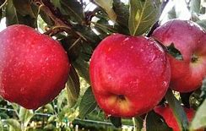
Future on the wholesale side: Improving the proven winners!
Gala
Red stains:
BL-14, Buckeye Prime, RedRidge, Brookfield, Ultima, Galaval, Crimson, many more
Early and late Strains:
Wildfire ( 2 weeks early) , Autumn ( 4 weeks later)

Slide 10
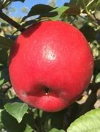
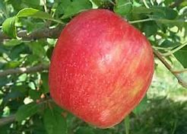
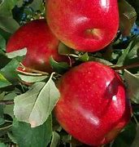
Future
Honeycrisp
Red strains: Roseland Red, Royal Red, Firestorm
Normal harvest time
Higher percent in first pick
Early: Premier
14 to 20 days early, Not a red strain
Good news, not preforming well in Washington, too hot to color

Slide 11
Premier honeycrisp
We have picked it for 7 years now
Has preformed well here
Picture is the 16th of Aug

Slide 12
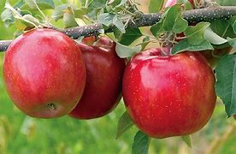
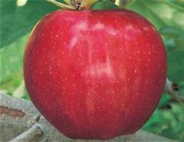
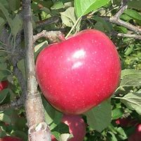
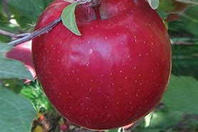
Future
Fuji Sports: Daybreak, Morning Mist, Auvil Early, Rising Sun
4 to 5 weeks earlier; easier to grow for our season
Ripen mid to late September:
Red Sports: Aztec
Ripens mid to late October

Slide 13
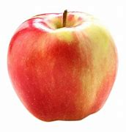
Ambrosia
Just came off Patent; Anyone can grow now
Ripens mid September
Already has spot on the shelf

Slide 14
Club Varieties
Most growers don’t have the ability to plant if not in the club
Usually controlled by large companies or by the state they are developed in
Company controlled = Rave, Sweet Tango, Pazazz
State controlled = Cosmic Crisp ( WA), Ruby Frost ( NY ), First Kiss (MN )

Slide 15
Club Varieties:
Do you have access or can you get it? ( Farm gate or direct to customer exceptions )
Getting much harder to get wholesale customers to take a new variety, very crowded shelf in stores
Last two years have made wholesale buyers much more cautious, sticking to old favorites

Slide 16
The crowded Club market

Slide 17
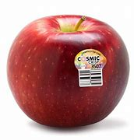
Cosmic Crisp
The 5 million bushel monster in the room (and more to come)
Expect 21 million bushel by 2026
Washington State only
Honeycrisp x Enterprise
17 million trees planted so far
Huge marketing budget, $10 million
Will have big effects on the whole sale market because of the:
Volume that will hit the market all at once.
The amount of money behind it
Some problems starting to pop up; one grocery chain has already dropped it

Slide 18
Direct Market side
Know your season, Know your customers
Are you selling just on your farm or at a farmer’s market that continues later into the year
Are there times in the season you have room to or need to add a variety?
Much easier to try new variety here. You have the customer there to talk to and explain the good qualities of a new variety
Put some in and try different ones
New high color sports can improve an older variety.
Just make sure we don’t pick it too soon just because color is there

Slide 19
Direct Market Side
Midwest Apple Improvement Association ( MAIA )
Great way for average grower to get access to new varieties
Pay yearly dues and become a member; Then yearly royalty per tree payments after that
Always working on adding more varieties that work well in the Midwest

Slide 20
MAIA
MAIA 1: Evercrisp
First release
Fuji X Honeycrisp
Ripens late October
Very crisp , sweet flavor
Stores very well
Hangs well, long picking window
Can have a muted Fuji color
Really manage crop load for best color
Very spindly tree, can become a bush if not pruned right

Slide 21
MAIA
MAIA-SM: Sweet MAIA
Honeycrisp X Winecrisp Cross
Ripens late August
Crisp sweet flavor
Hangs well, but flavor can change if left too long
Tends to be small, so good crop load management a must

Slide 22
MAIA
MAIA 11: Rosalee
Honeycrisp X Fuji cross
Harvests 2 weeks after Golden Delicious
A floral taste with a great texture

Slide 23
MAIA
MAIA 12: Summerset
Honeycrisp X Fuji Cross
Harvest is late Honeycrisp season
Very crisp texture with a more tangy flavor
Large fruit size

Slide 24
MAIA
MAIA-Z: Sweet Zinger
Gold Rush X Sweet 16
Harvests 3 weeks after Golden Delicious, late October
Very Crisp with sweet/tart flavor
Stores well
Large size fruit

Slide 25
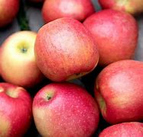
MAIA
MAIA-L: Ludacrisp
Harvests 3 weeks after Golden Delicious
Large fruit size
Tropical Flavor, very crispy
Must store for 3 to 4 weeks at least before proper flavor develops
Can taste “off “ at harvest time, this can be a bit tricky

Slide 26
Other Direct Market Varieties
Disease resistant varieties

Slide 27
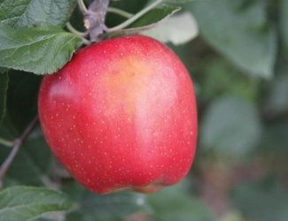
Disease Resistant
Galarina:
Gala type apple, crisp and sweet
Scab resistant
Good color; red to orange
Late September harvest
Hangs well and stores up to 4 months
Can be small so good crop load management is needed
More hardy then Gala

Slide 28
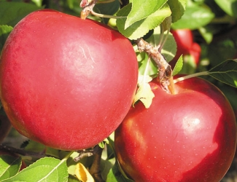
Disease Resistant
Crimson Crisp
Harvests in late September, just after honeycrisp
Very firm texture, with a tart flavor
Very pretty red apple , 95% color
Hangs well, stores up to 6 months
Grower friendly tree, low vigor
Medium size fruit
Scab resistant

Slide 29
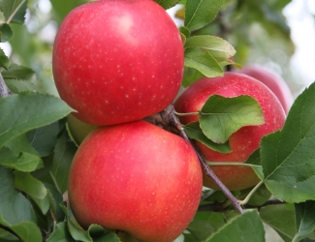
Disease Resistant
Ruby Rush
Goldrush X Enterprise Cross
Sweet flavor, crisp texture
Harvests late September
Very pretty red blush color
Stores well, up to 4 months
Resistance to scab, fire blight and cedar apple rust

Slide 30
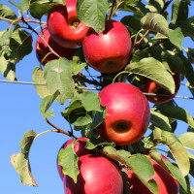
Disease Resistant
Story- Inored
Red Blush
Very dense apple, sweet flavor
Harvest is 4 weeks after golden delicious, Late October
Exceptional storage, up to 8 months
Scab resistant

Slide 31
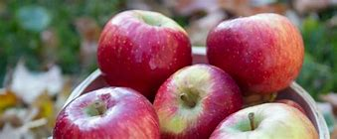
Disease Resistant
Triumph- MN80
Honeycrisp X Liberty cross
Nice red color
Tart, well balanced flavor
Harvest is late September
Good storage
Some stem bowl russeting
Scab resistant

Slide 32
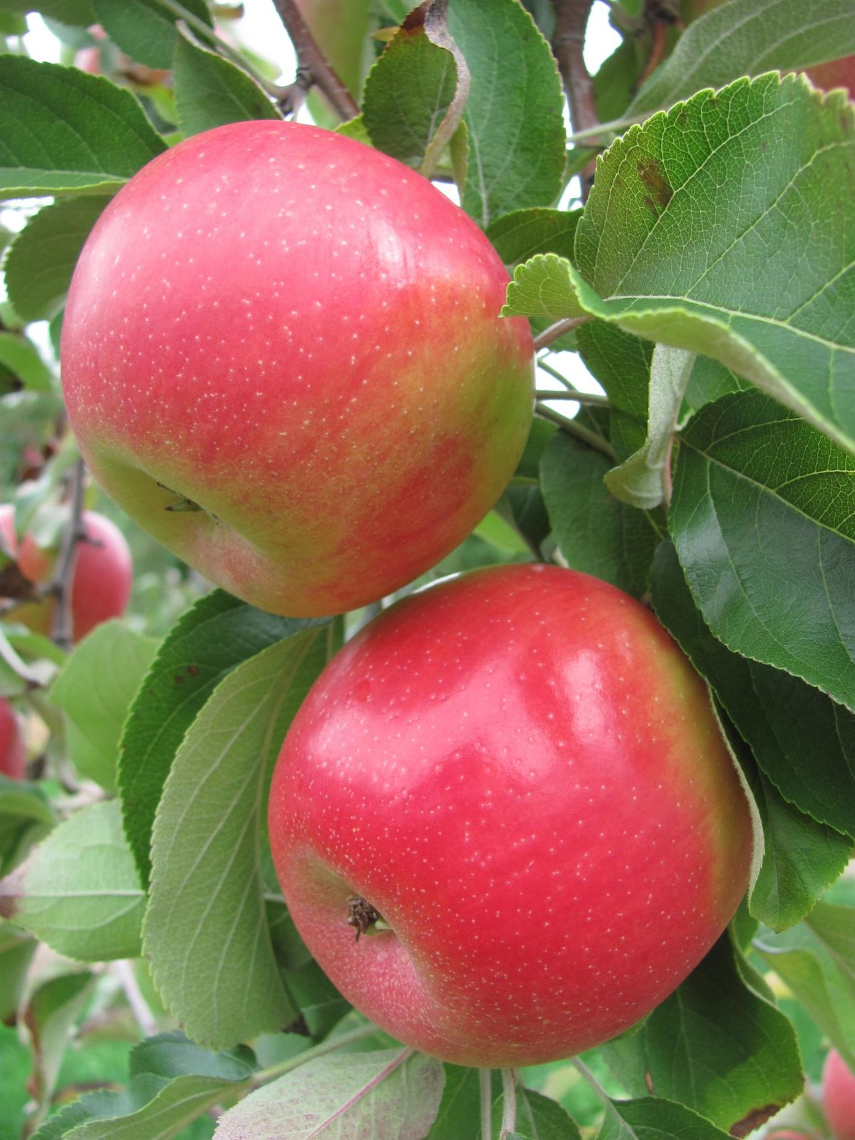
New York Release
Cordera: NY56
Slightly sweet
Scab and cedar rust immune
Harvest is early October
Large size
Low vigor tree

Slide 33
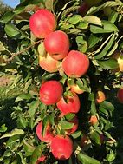
Other Interesting Varieties: Not disease resistant
Pink Luster- NY73
Also New York release
Harvest is mid September
Large size, conic shape
Crisp texture with attractive mild flavor
Pretty pink blush

Slide 34
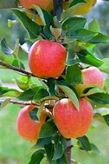
Another New York Release
Firecracker- NY109
Harvests Mid October
Firm and crisp
High brix
Full complex flavor, very aromatic
Long storage
Good for hard cider

Slide 35
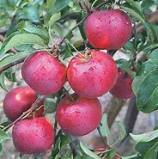
Other interesting Varieties
Pixie Crunch
Very crisp, sweet flavor
Harvests mid September
Hangs on tree well
Size can be small
Very popular with kids

Slide 36
Other interesting Varieties
Barnsby Pinklady
Can work on the wholesale side too
Same great pinklady apple but harvests 6 weeks early
Late October
Same tart flavor
Very pretty pink color
Very good storage, up to 6 months
Watch fire blight

Slide 37
Other Interesting Varieties
Dandee Red
Looks more like a McIntosh
Early Paula Red Sport
Harvest mid to late August a week a head of Paula Red
Large size, very firm fruit, pressure above 17
Stores well for early apple
Color is bright red over 90 % of the apple
Good early to mid season Mcintosh type apple

Slide 38
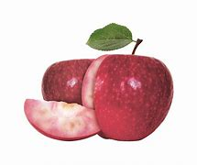
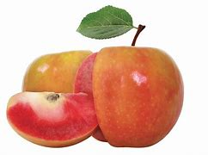
Other Interesting Varieties
Lucy; two varieties
Both red fleshed
Lucy Rosy
Red color, Sweet berry like flavor
Lucy Glo
Yellow color, tart with a hint of sweetness
Must have “Farmgate/ Farm market license”

Slide 39
Some others coming soon
Questions??????

